Slide 1
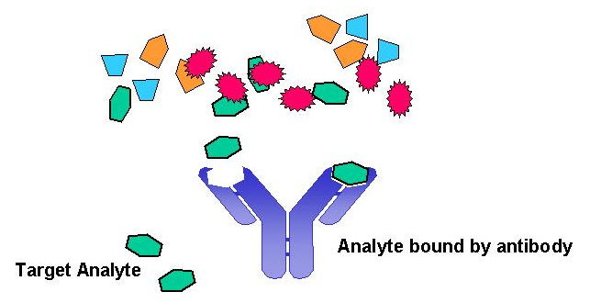
IMMUNOASSAYS
Fundamental Questions for an Analytical Chemist
How do you rapidly, cheaply and easily detect a single analyte present in a complex heterogeneous mixture (e.g., blood, soil, etc.) ?
Use a naturally occurring or synthetic analog of a molecule (antibody, aptamer, etc.) that has a high affinity to a specific ligand (or analyte)

Slide 2
IMMUNOASSAYS
Introduction
Definition of an immunoassay:
An immunoassay is an analytical technique which uses naturally occurring reagents known as antibodies for the selective determination of sample components
Immunoassays are commonly used in a wide variety of areas, especially in biochemistry and clinical chemistry
Examples of the application of immunoassay include:
Drug testing
Hormone testing (insulin in diabetic patients)
Bacterial or viral testing (AIDS, hepatitis)
Environmental testing (herbicides, pesticides)
Advantages of immunoassays are:
Inexpensive to perform
Highly selective
Low limits of detection
Can have high-throughput. Often done in batch mode
Applicable to the determination of a wide-range of compounds

Slide 3
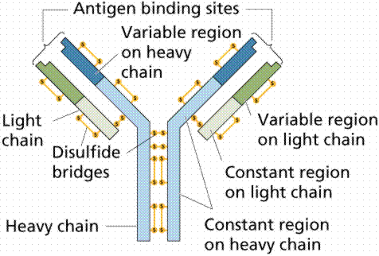
IMMUNOASSAYS
Antibodies
Definition of an antibody:
An antibody (Ab), or immunoglobulin (Ig), is a member of a family of glycoproteins that make up part of the body’s immune system.
Basic structure of an antibody:
The above antibody consists of four polypeptides-two identical heavy chains (H) and two identical light chains (L) connected by disulfide bonds. These are arranged in a “Y”-shaped structure ending with two identical sites that recognize and bind a given foreign agent or antigen

Slide 4
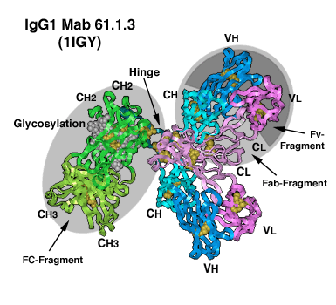
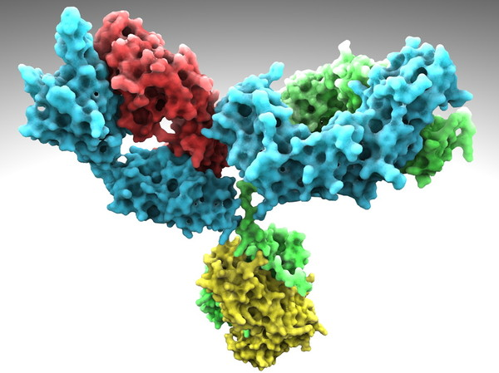
IMMUNOASSAYS
Antibodies
II. Basic structure of an antibody:
More realistic graphical representations of an antibody or Ig

Slide 5
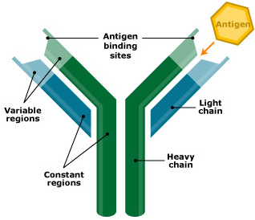
IMMUNOASSAYS
Introduction
Antibody – Antigen Interactions:
The body contains between 10⁶ and 10⁸ types of antibodies
Each antibody has the ability to bind to a different foreign agent, or antigen (Ag)
The ability of an antibody to recognize and bind a given antigen depends on the structure of its binding site
Determined by the amino acid sequence of the antibody near the N-terminal ends of the heavy and light chains

Slide 6
IMMUNOASSAYS
Introduction
Antibody – Antigen Interactions:
The general reaction between a single binding site on the antibody (Ab) and antigen (Ag) can be written as follows:
where K_{a} is the binding or association equilibrium constant
The value of K_{a} is typically in the range of 10⁶ to 10¹⁰ M⁻¹
The binding is very selective and only occurs between Ab and Ag, or between Ab and molecules similar to Ag in their three-dimensional structure.
K_{a}
Ab + Ag ↔ Ab-Ag

Slide 7
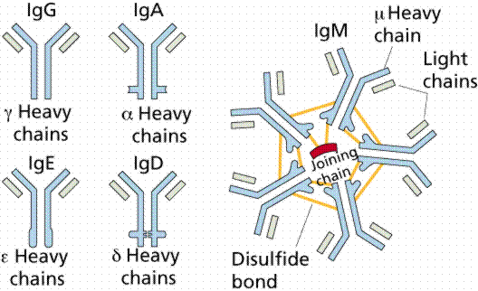
IMMUNOASSAYS
Introduction
Antibody Usage:
The selectivity of Ab-Ag interaction makes antibodies useful as analytical reagents for the determination of specific components in mixtures
Antibodies are useful as analytical reagents since they can be produced to a wide variety of substances:
For large analytes (> 5,000 MW), antibodies can be produced by directly injecting the compound into an animal
For small analytes (< 5,000 MW), antibodies can also be produced, but require that the compound first be coupled to a larger molecule, such as a protein, prior to injections
Five classes of antibodies

Slide 8
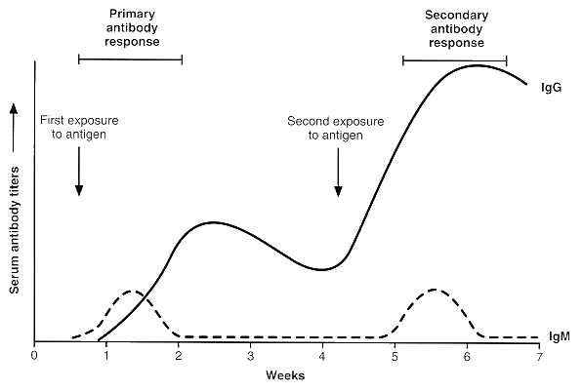
IMMUNOASSAYS
Introduction
Antibody Production - polyclonal antibodies :
One common method for making antibodies to a substance (antigen) is to inject the analyte or analyte-protein conjugate into an animal several times over a period of a few weeks to a few months

Slide 9
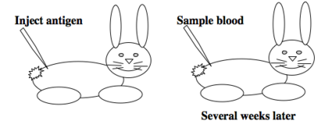
IMMUNOASSAYS
Introduction
Antibody Production – polyclonal antibodies:
If the agent is a foreign to the animal, the animal will develop antibodies to the agent and release these antibodies into its blood.
After a few months, blood is removed from the animal and the antibodies produced are collected for use
Antibodies produced in this fashion are typically very heterogeneous
Recognize a number of different sites on the analyte
Binding with a range of affinities (K_{a})
Heterogeneous antibodies are known as polyclonal antibodies
Arise from several different lines of antibody-producing cells within the animal

Slide 10
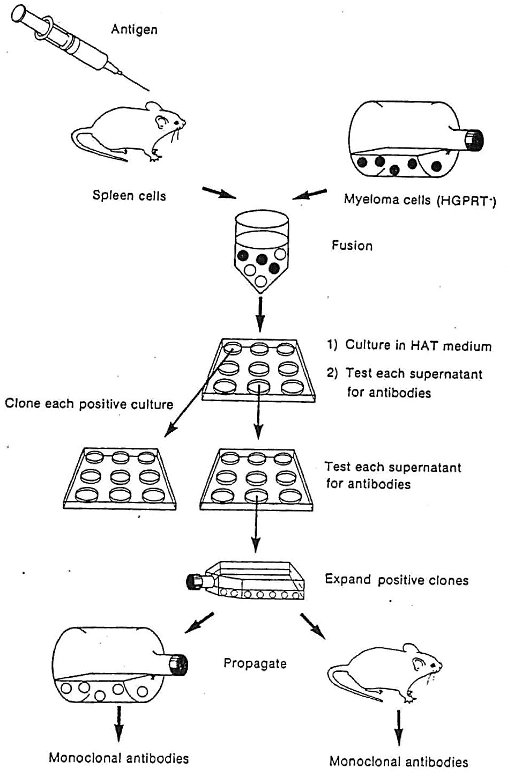
IMMUNOASSAYS
Introduction
Antibody Production - monoclonal antibodies (mAb):
Monoclonal antibodies differ from polyclonal antibodies in that they are produced by a single cell line within the body
All monoclonal antibodies from the same cell line recognize the same site on an analyte and bind with an identical binding affinity (K_{a})

Slide 11
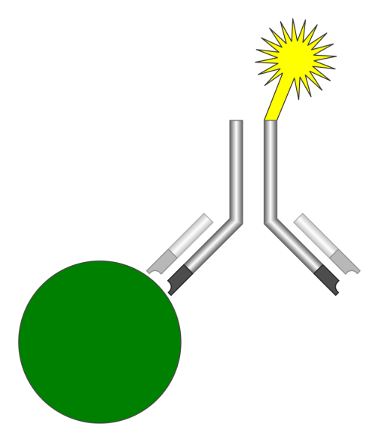
IMMUNOASSAYS
Types of Immunoassays
There are several different ways in which antibodies can be used in the detection or analysis of an antigen. Some common ways include:
Precipitation-based immunoassay
Competitive binding immunoassay
Sandwich immunoassay
All of these techniques use the specificity of antibodies as a means of selectively recognizing an analyte in the sample
The analyte reacting with the antibody is then detected either directly or through the use of various chemical labels which produce easy to measure signals
signal
mAb
antigen

Slide 12
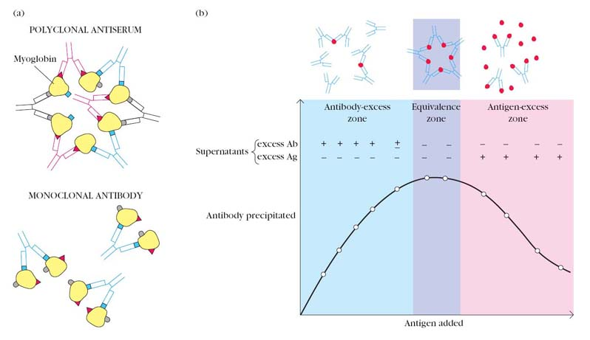
IMMUNOASSAYS
Precipitation assays
Use the antibody as a selective precipitation reagent for the determination of analyte in the sample
Involves the use of two or more types of antibodies that bind o different sites on the same analyte (i.e., polyclonal antibodies)
Since each antibody has two binding sites per molecule, this can result in precipitates being formed between Ab and Ag
Maximum precipitation occurs at some optimal Ab/Ag ratio
Soluble
Complexes
Insoluble
Complexes
Soluble
Complexes

Slide 13
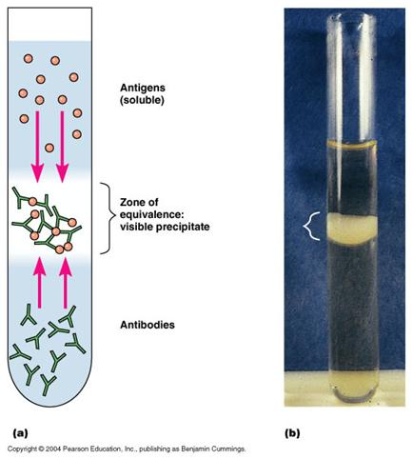
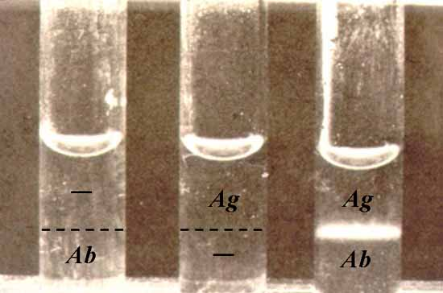
IMMUNOASSAYS
Precipitation assays
To quantitate analyte by this technique, typically take multiple aliquots of sample and add various amounts of antibody to each sample (i.e., titration)
The amount of precipitate formed for each aliquots is then determined visually, gravimetry, light scattering measurement, etc.

Slide 14
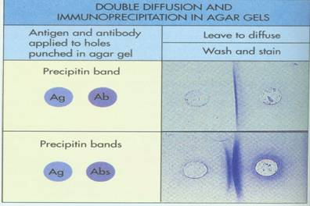
IMMUNOASSAYS
Precipitation assays
Technique can be performed in gels by having antibody and analyte diffuse towards each other from different sections of the gel
A concentration gradient of Ab and Ag is formed in the gel
Maximum precipitation will occur at the location where the antibody and analyte are both present in the correct ratio

Slide 15
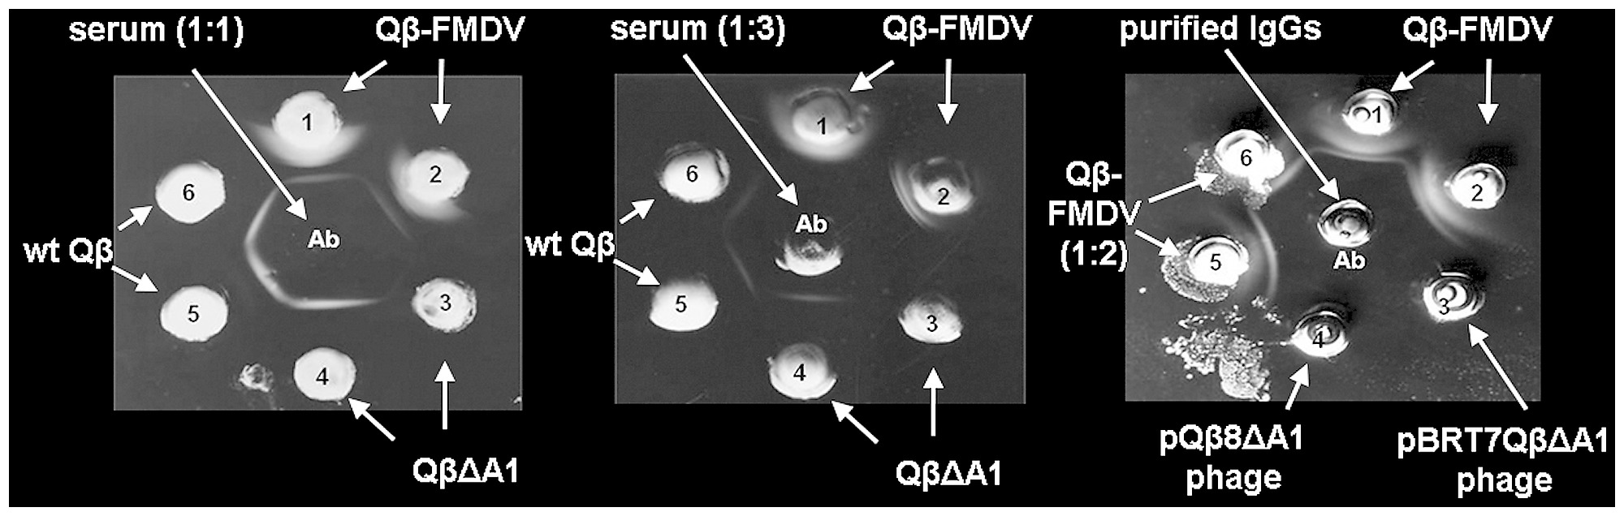
IMMUNOASSAYS
Precipitation assays
Precipitation in gels can be used either quantitatively or quantitatively to analyze the an analyte in the sample
Ouchterlony assay:
Qualitative method: formation of precipitate between sample and antibody wells indicates the sample contains analyte to which antibody binds
Skamel et al. (2014): PLOS ONE. 10.1371/journal.pone.0113069.g009.

Slide 16
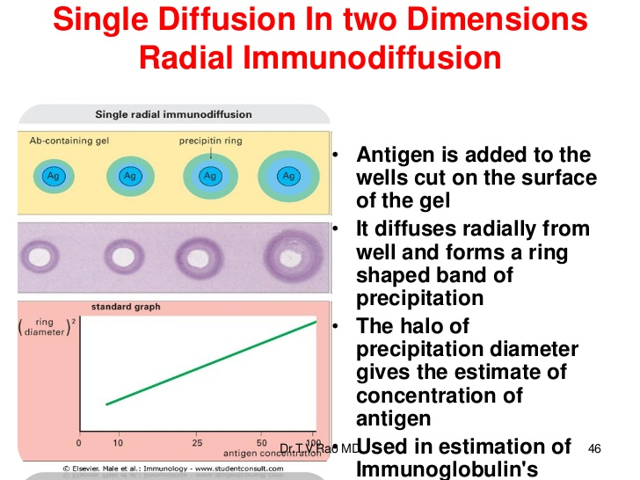
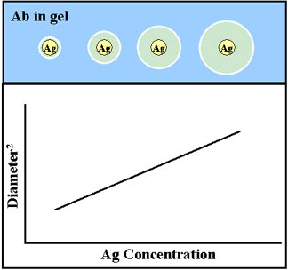
IMMUNOASSAYS
Precipitation assays
Precipitation in gels can be used either quantitatively or quantitatively to analyze the an analyte in the sample
Radial Immunodiffusion assay:
Quantitative method: area of ring within precipitation band is proportional to concentration of analyte in sample

Slide 17
IMMUNOASSAYS
Precipitation assays
Advantages of precipitation methods
Inexpensive-only reagent usually required is antibody
Selective-few interferences from other compounds in sample
Easy to perform
Disadvantages of precipitation methods
Only useful for fairly high concentration analytes (10-200 mg/L)
Long incubation times (hours-days)
Can require large amounts of antibody

Slide 18
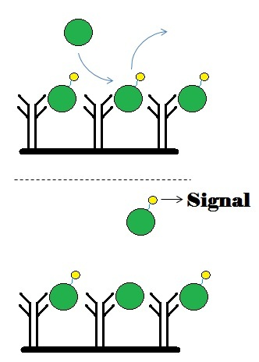
IMMUNOASSAYS
Competitive binding immunoassays
Quantitative method based on competition between analyte in sample and a fixed amount of labeled analyte for a limited number of antibody binding sites (equilibrium method)
Indirectly measures the amount of analyte in the sample by looking at amount of labeled analyte it displaces from the antibody
Unlabeled
antigen
Unlabeled antigen
displaces labeled antigen

Slide 19
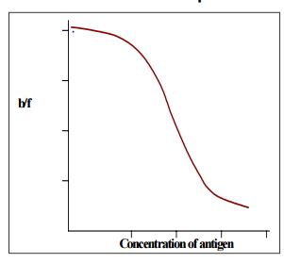
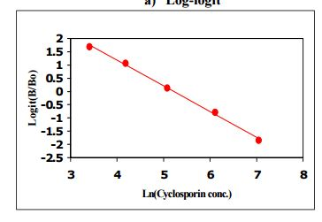

IMMUNOASSAYS
Competitive binding immunoassays
Quantitative method based on competition between analyte in sample and a fixed amount of labeled analyte for a limited number of antibody binding sites (equilibrium method)
A typical calibration curve for the assay
Linear
transform
Ln(antigen concentration)

Slide 20
IMMUNOASSAYS
Competitive binding immunoassays
Advantages of competitive binding immunoassay
Can be used with any type of analyte
Good limit of detection
Theoretical limit: 1/K_{a} or 10⁻⁶ to 10⁻¹⁰ M
Few interference from other compounds in sample
Disadvantages of competitive binding immunoassay
Some skill required to obtain optimum conditions for assay
Long incubation times (hours-days)
Limit of detection ultimately controlled by quality of antibody
Antibody binding strength (K_{a})
Detection limit varies between different antibody preparations
Usually manual method

Slide 21
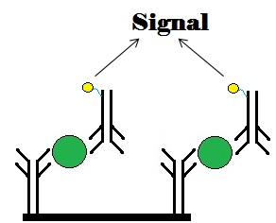
IMMUNOASSAYS
Sandwich immunoassays
Quantitative method based on use of two antibodies to detect analyte
First antibody extracts analyte from sample
Second antibody (containing chemical label) identifies presence of analyte
This type of assay measures the amount of analyte in the sample by looking at the amount of labeled antibody that binds to analyte on the solid support
Unlabeled
antigen
Solid
support
antigen “sandwiched”
between two antibodies

Slide 22
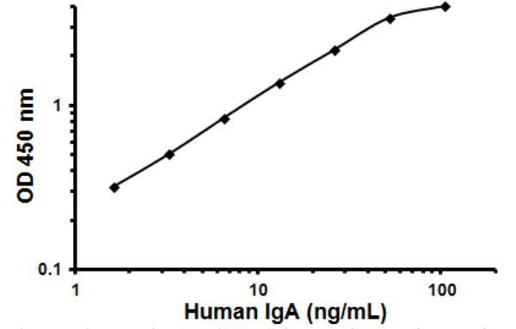
IMMUNOASSAYS
Sandwich immunoassays
Quantitative method based on use of two antibodies to detect analyte
A typical calibration curve for the assay
Response
Concentration of Analyte

Slide 23
IMMUNOASSAYS
Sandwich immunoassays
Advantages of sandwich immunoassay
Linear calibration curve
Lower limits of detection possible than with competitive binding immunoassay
< 10⁻¹² M
Greater selectivity than competitive binding assay
Two antibodies instead of one are used to recognize analyte
Shorter incubation times than competitive binding assay (hours vs. days)
Less susceptible to variations in quality of antibody preparation then competitive binding assay
Disadvantages of competitive binding immunoassay
Only useful for large analytes
1000 to 2000 MW
Requires enough room on molecule to bind two antibodies simultaneously
Requires multiple antibodies per analyte
Usually manual method

Slide 24
IMMUNOASSAYS
Labels for Immunoassays
The selectivity of a competitive binding assay depends on the specificity of the antibody
The use of a chemical label is also required
Several types of chemical labels have been used in immunoassays
Type of Label | Example | Measurement Principal | Limit of Detection
Radiolabels | I¹²⁵ | Radioactive delay | 10⁻¹³ M
Fluorescent | Fluorescein, Rhodamine | Fluorescence | 10⁻¹⁰ M
 | Rare earth chelates | Time-resolved fluorescence | 10⁻¹³ M
Enzymatic | Horse radish peroxidase | Formation of colored product by enzyme | 10⁻¹¹ M
Chemiluminescent | Acridinium esters, luminol | Light production by chemical reaction | 10⁻¹³ M

Slide 25
IMMUNOASSAYS
Learning Objectives:
The student should be familiar with the general definitions and advantages of “immunoassays” and some examples of the application of this field.
The student should be familiar with important features, structure and the production of antibodies and the intrinsic value to immunoassays.
The student should be familiar with the differences between monoclonal and polyclonal antibodies
The student should be familiar with the details of the antibody-antigen binding interaction
The student should be familiar with the different types of immunoassays, be able to describe how the assays function, and understand their advantages and disadvantages:
Precipitation-based immunoassay Competitive binding immunoassay Sandwich immunoassay
Ouchterlony assay Radial Immunodiffusion assay
The student should be familiar with the different labels for immunoassays, including how the label is measured and the limit of detection:
Radiolabels Fluorescent Enzymatic Chemiluminescent

