Slide 1
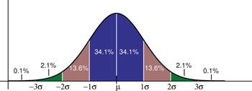
STATISTICAL TESTS FOR CHEMICAL ANALYSIS
Describing the Variation in Large Data Sets
Random variations will be present whenever we make a measurement:
A large number of experiments done under identical conditions will yield a distribution of results.
Equal chance of getting either high or low variations in a result – “bell-shape” curve centered around the average of the data set.
Distribution of results is known as Normal distribution of a Gaussian distribution
Width of ± 1 standard deviation (σ)
High population about mean (μ) or correct value
Number of Occurrences
low population far from correct value
Value

Slide 2
STATISTICAL TESTS FOR CHEMICAL ANALYSIS
Describing the Variation in Large Data Sets
Normal Distribution:
The shape of the Normal distribution of Gaussian Curve is described by the following equation:
μ is the average of the data set, which gives the central point for the distribution
σ is the standard deviation of the data set, which describes the width of this curve
II. If our results follow a Normal distribution, we can use the average and standard deviation for the data set to determine what fraction of our results will fall between any two measured values.

Slide 3
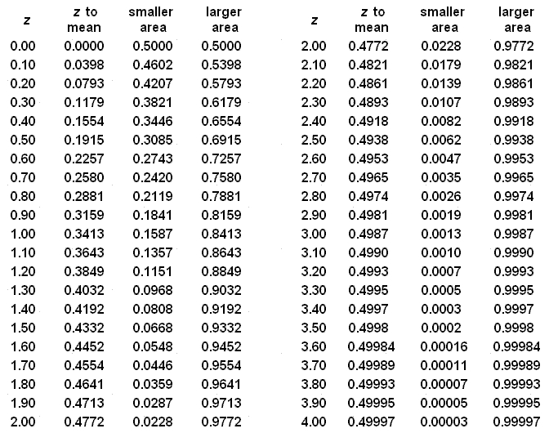
STATISTICAL TESTS FOR CHEMICAL ANALYSIS
The following table shows what fraction of results (as represented by the area under the Normal distribution will occur between the mean and a value x.

Slide 4
STATISTICAL TESTS FOR CHEMICAL ANALYSIS
Describing the Variation in Large Data Sets
By knowing the standard deviation (σ) and the average (μ):
The probability of the next result falling in any given range can be calculated by:
Describes the difference between x and m in terms of the number of standard deviations that separate these two values.
Probability of Measuring a value in a certain range is equal to the area of that range
As an example, a range of one standard deviation above or below the mean (μ±1σ) corresponds to a relative area of 2(0.3413) = 0.6826 or 68.3% of the results in a normal distribution, or roughly two thirds of all its values
Standard Deviation (s) | Probability
±1σ | 68.3%
±2σ | 95.5%
±3σ | 99.7%
±4σ | 99.9%

Slide 5
STATISTICAL TESTS FOR CHEMICAL ANALYSIS
Describing the Variation in Small Data Sets
For a small set of numbers:
The experimental values of $\overline{x}$and s are only estimates of the true average (μ) and standard deviation (σ).
We must always consider how precisely we know $\overline{x}$and s when we use these to describe experimental data.
Standard Deviation of the Mean:
In the same way that we use s to describe the variation within a data set, we can employ the standard deviation of the mean ($s_{\overline{x}}$) to describe the precision of our experimental average ($\overline{x}$)
The standard deviation of the mean ($s_{\overline{x}}$) is determined by using the standard deviation of the entire data set (s) and the number of data points (n) in this data set:

Slide 6
STATISTICAL TESTS FOR CHEMICAL ANALYSIS
Describing the Variation in Small Data Sets
Standard Deviation of the Mean:
The size of $s_{\overline{x}}$ is always less than or equal to s since n must be greater than or equal to one
Whenever a standard deviation for a mean is reported, you also need to state the number of points in your data set - $s_{\overline{x}}$ depends on n
Relative size of $s_{\overline{x}}$ versus s
Number of Assays Required (n)

Slide 7
STATISTICAL TESTS FOR CHEMICAL ANALYSIS
Describing the Variation in Small Data Sets
Standard Deviation of the Mean:
The standard deviation for an entire set (s) approaches a constant value (s) as we increase n
The size of $s_{\overline{x}}$ becomes smaller as we increase n
This occurs because the precision of the experimental average decreases as we acquire more data
x is a more reliable estimate of the true average as n increases
Relative size of $s_{\overline{x}}$ versus s
Number of Assays Required (n)

Slide 8
STATISTICAL TESTS FOR CHEMICAL ANALYSIS
Describing the Variation in Small Data Sets
Confidence Intervals:
Common in science to describe the variation in experimental numbers by using a range of values
Report a result by giving the mean plus or minus two standard deviations of the mean:
The range of values that follows the mean is called the confidence limit
The mean plus this range is known as the confidence interval (or C.I.)

Slide 9
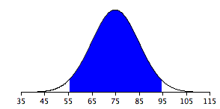
STATISTICAL TESTS FOR CHEMICAL ANALYSIS
Describing the Variation in Small Data Sets
Confidence Intervals:
II. When reporting a confidence interval, the number placed in front of $s_{\overline{x}}$ helps specify the degree of certainty that the experimenter has in the result
For a Normal distribution, a range of approximately ± 2 standard deviations means there is roughly a 95% chance that any given value in the data set will fall in this range
Only a 5% chance that a value will fall outside of this range
95% of the area of a Normal distribution or Gaussian curve
-2σ +2σ

Slide 10
STATISTICAL TESTS FOR CHEMICAL ANALYSIS
Describing the Variation in Small Data Sets
Confidence Intervals:
III. Relatively easy to determine the meaning of these ranges for large groups of numbers, this becomes more complicated for small data sets
Mean and standard deviations are only estimates of their true value
Always a greater uncertainty when working with small data sets
Requires the use of larger confidence intervals
Use a correction factor known as the Student’s t value (t)
Express the confidence interval for an entire population of results based on s
Express the confidence interval for the measurement of a mean based on $s_{\overline{x}}$

Slide 11
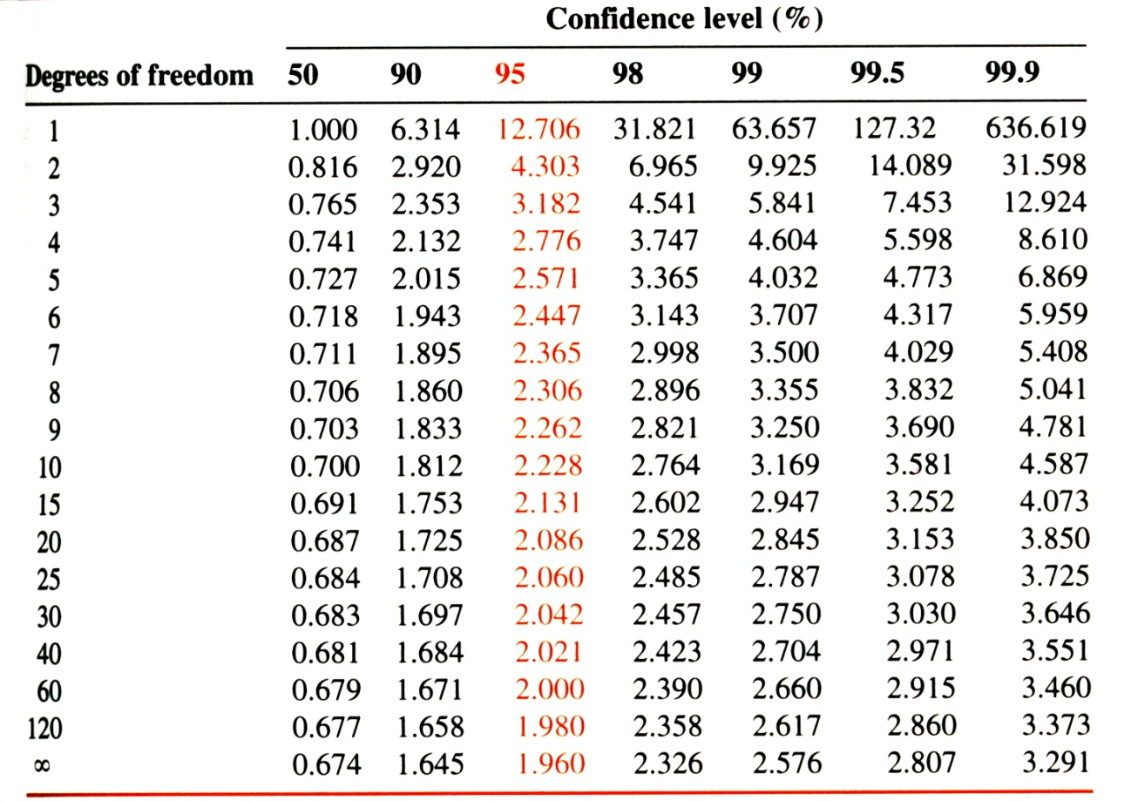
STATISTICAL TESTS FOR CHEMICAL ANALYSIS
The following table gives the Student’s t values for a given number of points (n) in your data set as represented by the degrees of freedom (ν ).
Student’s t value also depends on the desired degree of certainty – Confidence level
As n becomes large, t approaches ~ 2
(± 2 standard deviations)

Slide 12
STATISTICAL TESTS FOR CHEMICAL ANALYSIS
Example – Calculating a Confidence Interval
Probenecid is a drug used by some athletes to prevent the excretion of other substances into urine, thus lowering their detectable concentrations. A scientist makes three measurements of a urine sample known to contain probenecid. He gets a mean result of 11.8 μg/L and a standard deviation for the entire set of results of 0.2 μg/L
What is the 95% confidence interval for this mean?
Solution: Since we are looking at the mean, we first need to find $s_{\overline{x}}$
Next, look-up the Student’s t value from the table at the correct degrees of freedom of 2
at the 95% confidence level, t = 4.303

Slide 13
STATISTICAL TESTS FOR CHEMICAL ANALYSIS
Example – Calculating a Confidence Interval
Probenecid is a drug used by some athletes to prevent the excretion of other substances into urine, thus lowering their detectable concentrations. A scientist makes three measurements of a urine sample known to contain probenecid. He gets a mean result of 11.8 μg/L and a standard deviation for the entire set of results of 0.2 μg/L
What is the 95% confidence interval for this mean?
Solution: With $s_{\overline{x}}$ = 0.12 μg/L and t = 4.303, we can now calculate the confidence interval:
Note: always state the number of data points and confidence level when a confidence
interval is reported

Slide 14
STATISTICAL TESTS FOR CHEMICAL ANALYSIS
Comparing Experimental Results
General Requirements for the Comparison of Data:
There are four items you need when using statistics to compare experimental results:
The TEST STATISTIC
“How will I compare my result and model?”
The CONFIDENCE LEVEL
“How certain do I want my answer to be?”
The HYPOTHESIS
“Is my result the same as the model?”
The MODEL
“What is my result being compared to?”

Slide 15
STATISTICAL TESTS FOR CHEMICAL ANALYSIS
Comparing Experimental Results
The MODEL - refers to the value or predicted behavior to which the experimental results are going to be compared.
This could be an equation, a predicted distribution, the values obtained by another method, or the known value for a reference standard.
The HYPOTHESIS - is an initial guess for the results of the statistical test..
When comparing analytical results, the hypothesis can be either:
the results will fit the model – the null hypothesis
the results will not fit the model – the alternate hypothesis
The CONFIDENCE LEVEL - represents the degree of certainty required in the comparison.
Scientific results have some degree of uncertainty because of random errors
Confidence level estimates the extent of this uncertainty to avoid reaching unreasonable conclusions about the data.
The TEST STATISTIC - a numerical value calculated from the data to use in the comparison (e.g., Student’s t value).
The test statistic calculated from the results is compared to a critical value that represents the largest value is expected for a given number of data points and confidence level.

Slide 16
STATISTICAL TESTS FOR CHEMICAL ANALYSIS
Comparing Experimental Results
Comparing an Experimental Result with a Known Reference Value:
If the reference value is known exactly, or at least has much better precision than the results, then
The known reference value represents the true “mean” for the sample, μ
The experimental results is the measured mean for the sample, x
The Student’s t value is the test statistic
Student’s t test
Assume the reference value (μ) and the experimental results (x) are the same – the null hypothesis
Test this assumption by calculating a Student’s t value
The lines shown on either side of “x - μ” indicate the absolute or positive value of the difference

Slide 17
STATISTICAL TESTS FOR CHEMICAL ANALYSIS
Comparing Experimental Results
Comparing an Experimental Result with a Known Reference Value:
III. Once t is calculated for the data, need to compare this to a critical value (t_{c}) obtained from a table of expected Student’s t values
The selected t_{c} value is determined by the number of data points (n) used to find the experimental mean (degrees of freedom, n-1)
The selected t_{c} value is determined by the confidence level chosen for the comparison
IV. If t ≤ t_{c}, then x and μ are not significantly different at the stated confidence level.

Slide 18
STATISTICAL TESTS FOR CHEMICAL ANALYSIS
Example – Comparing an Experimental Result and a Known Reference Value
Action is taken against Olympic athletes if their urine is found to contain caffeine concentrations above 12.00 μg/mL. A sample from one athlete gives a mean caffeine concentration of 11.85 mg/mL for five measurements (range, 11.65 to 12.10 μg/mL) with a standard deviation for this mean being 0.07 μg/mL. The athlete's coach argues that this result is statistically the same as the 12.00 μg/mL cutoff.
Are these two values equivalent at the 95% confidence level?
Solution: The model in this example is 12.00 mg/mL, and the confidence level is 95%. To see if the mean and the reference value are the same (underlying hypothesis) calculate the Student’s t value:
Next, look-up the critical Student’s t value from the table at the 95% confidence level and at a degrees of freedom of (5-1)=4

Slide 19
STATISTICAL TESTS FOR CHEMICAL ANALYSIS
Example – Comparing an Experimental Result and a Known Reference Value
Action is taken against Olympic athletes if their urine is found to contain caffeine concentrations above 12.00 μg/mL. A sample from one athlete gives a mean caffeine concentration of 11.85 mg/mL for five measurements (range, 11.65 to 12.10 μg/mL) with a standard deviation for this mean being 0.07 μg/mL. The athlete's coach argues that this result is statistically the same as the 12.00 μg/mL cutoff.
Are these two values equivalent at the 95% confidence level?
Solution: at the 95% confidence level and v = 4, t_{c} = 2.776
Since t_{c} of 2.776 is greater than the experimental t value of 2.14, the amount of caffeine in the athlete’s sample was the same as the allowed cutoff level at a 95% confidence level

Slide 20
STATISTICAL TESTS FOR CHEMICAL ANALYSIS
Comparing Experimental Results
Comparing Two Experimental Means:
Mean results for two samples (x₁ and x₂) measured by the same method or two methods with similar precision – are they the same?
The model would be one of the two means
The hypothesis is determining if the two results represent the same number
The Student’s t value is the test statistic
Pooled Standard Deviation (s_{pool})
Both experimental result and “model” have some uncertainty in their values
Instead of using standard deviation for either of these means, the pooled standard deviation (s_{pool}) reflects the variation in both results
where
s₁ and s₂ are the estimated standard deviations for the two datasets
n₁ and n₂ are the number of points for the two datasets

Slide 21
STATISTICAL TESTS FOR CHEMICAL ANALYSIS
Comparing Experimental Results
Comparing Two Experimental Means:
Pooled Standard Deviation (s_{pool})
s_{pool} is the weighted average of the individual standard deviations
Just like s can be used to find the standard deviation of the mean x, s_{pool} can be used to determine the standard deviation for the pooled mean ($s_{\overline{x}pool}$ ):
If x₁ and x₂ represent the same value, their difference (x₁ - x₂ ) should fall within a reasonably small number of standard deviations for this difference
(x₁ - x₂ ) can be compared directly to $s_{\overline{x}pool}$, where a ratio gives an experimental Student’s t value for the dataset:

Slide 22
STATISTICAL TESTS FOR CHEMICAL ANALYSIS
Comparing Experimental Results
Comparing Two Experimental Means:
IV. Once t is calculated for the data, need to compare this to a critical value (t_{c}) obtained from a table of expected Student’s t values
The selected t_{c} value is determined by the number of data points (n₁ and n₂) used to find the experimental means (degrees of freedom, n₁+n₂-2)
The selected t_{c} value is determined by the confidence level chosen for the comparison
V. If t ≤ t_{c}, then x₁ and x₂ represent the same value at the stated confidence level.

Slide 23
STATISTICAL TESTS FOR CHEMICAL ANALYSIS
Example – Comparing Two Mean Results
Human chronic gonadotropin (hCG) is a naturally-occurring substance that has been abused by some athletes because of its ability to stimulate testosterone production. Two labs that perform athletic drug testing are to be evaluated for their ability to measure this hormone by using the same sample and analysis method. The first lab reports a mean hCG level of 2.99 IU/L (n₁ = 4) with a standard deviation of 0.06 IU/L, while the second lab obtains a mean level of 3.13 IU/L (n₂ =5) with a standard deviation of 0.08 IU/L
Are these mean results the same at the 95% confidence level?
Solution: If we assume that the standard deviations for the two means are approximately the same, the first step is to get the pooled standard deviation:

Slide 24
STATISTICAL TESTS FOR CHEMICAL ANALYSIS
Solution: Next, we can use s_{pool} , n₁ and n₂ to determine the standard deviation of the pooled mean ($s_{\overline{x}pool}$):
We are now ready to calculate the experimental Student’s t value for our results:

Slide 25
STATISTICAL TESTS FOR CHEMICAL ANALYSIS
Solution: The degrees of freedom in this case is:
(4 + 5 -2) = 7
At a 95% confidence level, the critical t_{c} value is 2.36
When we compare the experimental t value and the critical t_{c} value:
t is greater than t_{c} (2.9 > 2.36)
The mean results from the two labs are significantly different at the 95% confidence level

Slide 26
STATISTICAL TESTS FOR CHEMICAL ANALYSIS
Comparing Experimental Results
Comparing Two Sets of Experimental Data:
Mean results for one sample measured by two different methods (x₁ and x₂) – are they the same?
The two methods need to have the same precision
Paired Student’s t test
Make a list of the results obtained by both methods for each sample
 | Mean results (μmol/L) |  | Difference in Results (μmol/L)
Sample No. | Method 1 (x₁) | Method 2 (x₂) | d_{i} = x₁-x₂
1 | 2.53 | 2.68 | -0.15
2 | 5.19 | 5.03 | 0.16
3 | 3.60 | 3.79 | -0.19
4 | 6.42 | 6.51 | -0.09
5 | 7.08 | 7.24 | -0.16
 |  |  | $\overline{\overline{d}=\sum{(d_{i})/n}}$ = -0.086 μmol/L

Slide 27
STATISTICAL TESTS FOR CHEMICAL ANALYSIS
Comparing Experimental Results
Comparing Two Sets of Experimental Data:
Paired Student’s t test
The difference between each set of results is calculated (d_{i})
The average of the differences in the results is averaged ($\overline{d}$)
$$\overline{d}=\sum{(d_{i})/n}$$
To determine whether the differences in these results are significant, we need to calculate the standard deviation in these differences (s_{d}):
Next, calculate the standard deviation in the average difference ($s_{\overline{d}}$)

Slide 28
STATISTICAL TESTS FOR CHEMICAL ANALYSIS
Comparing Experimental Results
Comparing Two Sets of Experimental Data:
Paired Student’s t test
If the differences in the results for methods one and two represent only random variations, then the average difference in these results should be similar in size to $s_{\overline{d}}$.
The experimental Student’s t value for this analysis is calculated as follows:
Compare the experimental t value, to a critical Student’s t_{c} value
Required confidence level at n - 1 degrees of freedom
N now represents the number of data point pairs being compared
If t ≤ t_{c}, the two methods produce statistically identical values at the given confidence level

Slide 29
STATISTICAL TESTS FOR CHEMICAL ANALYSIS
Example – Paired Student’s t Test
Corticosteroids can legitimately be used by athletes for the relief of inflammation and pain. But the injection or inhalation of these compounds is allowed only when needed for a medical condition. A new technique for the measurement of corticosteroids in urine is to be compared with a previous method. Both approaches have similar precision and are used to analyze a series of identical samples. The new method gives mean results of 2.53, 5.19, 3.60, 6.42, and 7.08 μmol/L for five separate samples, while the older method gives means of 2.68, 5.03, 3.79, 6.51 and 7.24 μmol/L for the same samples.
Are the results from these methods equivalent at the 95% confidence level?
Solution: Use a paired Student’s t test, and first list the results for all samples side-by-side:
 | Mean results (μmol/L) |  | Difference in Results (μmol/L)
Sample No. | Method 1 (x₁) | Method 2 (x₂) | d_{i} = x₁-x₂
1 | 2.53 | 2.68 | -0.15
2 | 5.19 | 5.03 | 0.16
3 | 3.60 | 3.79 | -0.19
4 | 6.42 | 6.51 | -0.09
5 | 7.08 | 7.24 | -0.16
 |  |  | $\overline{\overline{d}=\sum{(d_{i})/n}}$ = -0.086 μmol/L

Slide 30
STATISTICAL TESTS FOR CHEMICAL ANALYSIS
Solution: Calculate the difference between each pair of results, and then the average difference between the two methods: -0.086 μmol/L
Calculate s_{d}:
Calculate $s_{\overline{d}}$:

Slide 31
STATISTICAL TESTS FOR CHEMICAL ANALYSIS
Solution: Calculate the experimental Student’s t value
The degrees of freedom in this case is: n - 1 = 5 - 1= 4
At a 95% confidence level, the critical t_{c} value is 2.78
When we compare the experimental t value and the critical t_{c} value:
t is less than t_{c} (1.4 < 2.78)
The results from the two methods are equivalent at the 95% confidence level

Slide 32
STATISTICAL TESTS FOR CHEMICAL ANALYSIS
Comparing Experimental Results
Comparing the Variation in Results:
Compare the precision of two results or methods
The methods we have discussed to this point require similar precision
F test
The model is the method or result with the smallest standard deviation (s₁)
The hypothesis is that the standard deviation from the second method or result (s₂) is the same as the model’s standard deviation (s₁)
The test statistic is the ratio of the squared standard deviations:
Since s₁ < s₂, F should always be greater than or equal to one
As F becomes larger, there is a greater likelihood that s₁ and s₂ represent different numbers

Slide 33
STATISTICAL TESTS FOR CHEMICAL ANALYSIS
Comparing Experimental Results
Comparing the Variation in Results:
F test
After F is calculated for the data set, it needs to be compared to an appropriate critical value - F_{c}
The F_{c} value is determined by the desired confidence level
The F_{c} value is determined by the degrees of freedom:
v₁ = n₁ -1 and v₂ = n₂ -1
where n₁ and n₁ are the number of points for data sets one and two
If F ≤ F_{c}, the precision of the two methods is equivalent at the selected confidence level

Slide 34
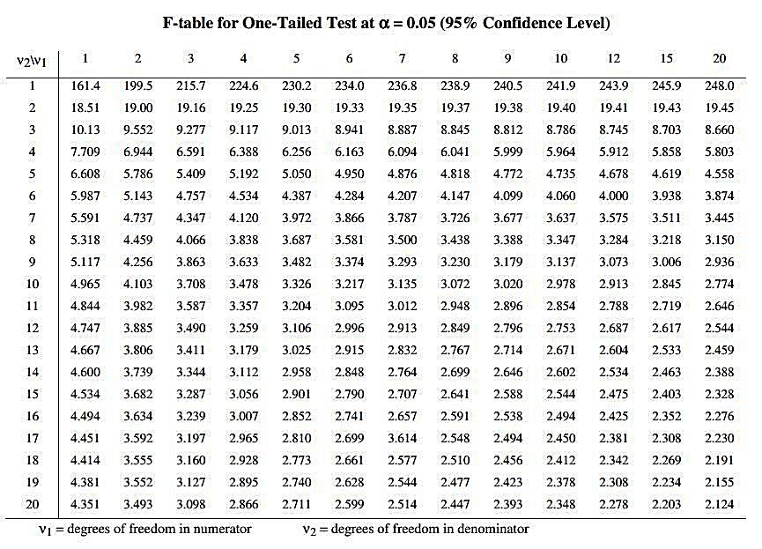
STATISTICAL TESTS FOR CHEMICAL ANALYSIS

Slide 35
STATISTICAL TESTS FOR CHEMICAL ANALYSIS
Example – Comparing the Precision of Two Methods by the F-Test
It is known that the two methods in the previous example have standard deviations of 0.09 and 0.16 μmol/L (for n₁ = n₂ = 5) at a corticosteroid concentration of 5.0 μmol/L
Are the precisions of these two methods the same at the 95% confidence level?
Solution: Set s₂ equal to 0.16 and s₁ equal to 0.09, so that s₂ > s₁, and determine F:
From the Table on the previous slide, the F_{c} critical value at the 95% confidence level for the two degrees of freedom (v₁ = n₁-1 = 5-1 =4 and v₂ = n₂-1 = 5-1 =4) is 6.39
Since F ≤ F_{c} (3.2 ≤ 6.39), the two methods have the same precision at the 95% confidence level.

Slide 36
STATISTICAL TESTS FOR CHEMICAL ANALYSIS
Detecting Outliers
Variations are Always Present for Repeated Measurements on a Sample:
A data point that is very different from others obtained under supposedly identical conditions is suspect
Is this due to a problem with the experiment?
Experience can be used to identify an obviously erroneous data point and remove it from the dataset
There are other occasions when experience is not sufficient, the data point doesn’t appear to fit the general trend for other results, but is it an outlier?
Various tests for determining if a data point is outside the variation normally expected for a dataset
Only used for identifying outliers
Not the sole means for justifying the removal of a data point
Thorough knowledge of the methods and conditions should always have the “last word” in determining whether a point should be kept in a data set

Slide 37
STATISTICAL TESTS FOR CHEMICAL ANALYSIS
Detecting Outliers
Variations are Always Present for Repeated Measurements on a Sample:
III. Q Test
Based on the absolute difference between a suspect data point’s value and the nearest data point. This difference is then compared to the total range of values in the data set.
If the difference between the suspect data point and its nearest neighbor is greater than a certain critical fraction of the total range, then the suspected value is a “true” outlier
IV. Application of the Q test
Rank the results from the data set from lowest to highest
Define the suspected outlier x_{o} and its nearest neighbor x_{n}
Define the highest number (x_{high}) and the lowest number (x_{low}) in the data set
Calculate the following ratio (Q):

Slide 38
STATISTICAL TESTS FOR CHEMICAL ANALYSIS
Detecting Outliers
Variations are Always Present for Repeated Measurements on a Sample:
IV. Application of the Q test
Compare the calculated value for Q to a critical test value, Q_{c}
The critical test value will depend on the total number of results in the data set
The critical test value will depend on defined confidence level
If Q > Q_{c}, the suspected point can be called an outlier and considered for rejection

Slide 39
STATISTICAL TESTS FOR CHEMICAL ANALYSIS
 | Values for Q_{c} at Various Confidence Levels
Number of Values in Data Set | 90% | 95% | 99%
3 | 0.941 | 0.970 | 0.994
4 | 0.765 | 0.829 | 0.926
5 | 0.642 | 0.710 | 0.821
6 | 0.560 | 0.625 | 0.740
7 | 0.507 | 0.568 | 0.680
8 | 0.468 | 0.526 | 0.634
9 | 0.437 | 0.493 | 0.598
10 | 0.412 | 0.466 | 0.568
11 | 0.392 | 0.444 | 0.542
12 | 0.376 | 0.426 | 0.522
13 | 0.361 | 0.410 | 0.503
14 | 0.349 | 0.396 | 0.488
15 | 0.338 | 0.384 | 0.475
16 | 0.329 | 0.374 | 0.463
17 | 0.320 | 0.365 | 0.452
18 | 0.313 | 0.356 | 0.442
19 | 0.306 | 0.349 | 0.433
20 | 0.300 | 0.342 | 0.425

Slide 40
STATISTICAL TESTS FOR CHEMICAL ANALYSIS
Example – Outlier Detection by the Q Test
A urine sample containing a known amount of markers for marijuana is sent to several drug testing labs to evaluate their ability to monitor such compounds. These labs report the following concentrations: Lab 1: 55.3 μg/L, Lab 2: 57.8 μg/L, Lab 3: 54.0 μg/L, lab 4: 68.1 μg/L, and Lab 5 58.7 μg/L
Use the Q test to determine if any of these results can be considered an outlier at the 95% confidence level
Solution: The low and high values in the group are 54.0 and 68.1 μg/L. The result of 68.1 μg/L is the most likely outlier since it is the furthest from its neighbor, 58.7 μg/L.
Calculate a Q value:

Slide 41
STATISTICAL TESTS FOR CHEMICAL ANALYSIS
Example – Outlier Detection by the Q Test
A urine sample containing a known amount of markers for marijuana is sent to several drug testing labs to evaluate their ability to monitor such compounds. These labs report the following concentrations: Lab 1: 55.3 μg/L, Lab 2: 57.8 μg/L, Lab 3: 54.0 μg/L, lab 4: 68.1 μg/L, and Lab 5 58.7 μg/L
Use the Q test to determine if any of these results can be considered an outlier at the 95% confidence level
Solution: The number of points in this data set is 5 – note: it is not a degrees of freedom
At a 95% confidence level, the critical Q_{c} value is 0.710 from the table on the previous slide
Since the calculated Q is less than the critical Q_{c} value ( (0.667 < 0.710), the point at 68.1 μg/L can not be called an outlier at the 95% confidence level

Slide 42
STATISTICAL TESTS FOR CHEMICAL ANALYSIS
Fitting Experimental Results
Linear Regression:
How to fit an equation or line to a set of results
Many types of equations, but the most common is a straight line
A common method for deterring the best-fit line for a data set is a process known as linear regression
Application of Linear Regression
Involves a set of (x, y) values
y is the dependent variable, and x is the independent variable
Fit to an equation with the following form:
where:
m is the slope (representing the change in y versus x)
b is the line’s intercept on the y-axis
x_{i} is a given x value in the data set
y_{i,calc} is the response predicted at x_{i} by the best-fit line

Slide 43
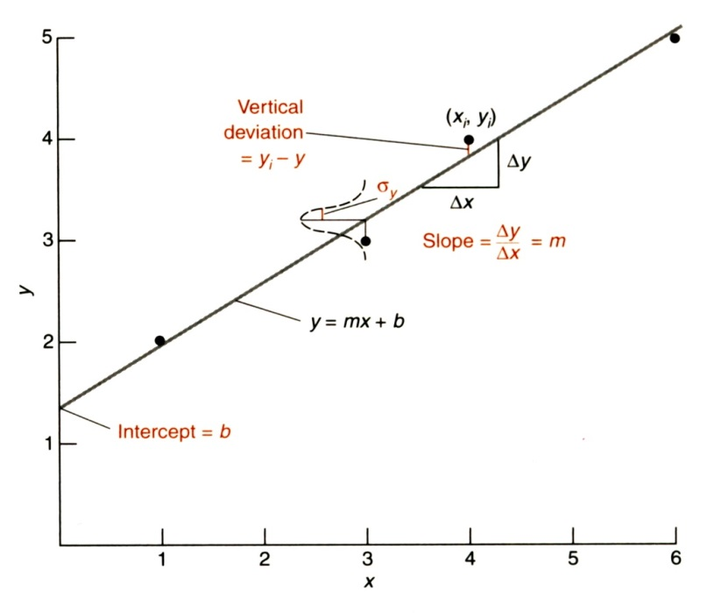
STATISTICAL TESTS FOR CHEMICAL ANALYSIS
Fitting Experimental Results
Application of Linear Regression
Obtain the best estimates for m and b by using the method of least squares analysis.
Least squares analysis results in a series of equations that allow the slope and intercept for the best-fit line to be calculated for a particular data set based on the number of points in the data set (n) and the values for each (x, y) pair
Can be calculated manually, best-fit lines are routinely determined using a computer

Slide 44
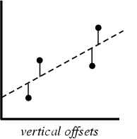
STATISTICAL TESTS FOR CHEMICAL ANALYSIS
Fitting Experimental Results
III. Least Squares Analysis.
Minimize vertical deviation between points and line
Use square of the deviations → deviation irrespective of sign

Slide 45
STATISTICAL TESTS FOR CHEMICAL ANALYSIS
Example – Determining the Best-Fit Parameters for a Line
A set of urine standards that contain the drug oxymorphone are analyzed and give a calibration curve that appears to follow a straight line. The peak heights measured by liquid chromatography for standards with oxymorphone concentrations of 100, 200, 300, 400, and 500 ng/mL have relative values of 161, 342, 543, 765, and 899, respectively.
Determine the best-fit slope and intercept for this line.
Solution: The easiest approach to solve this problem is to prepare a table, which has separate columns for each x and y pair, as well as for the calculated values of and $x_{i}y_{i}$. The numbers in each column are then summed:

Slide 46
STATISTICAL TESTS FOR CHEMICAL ANALYSIS
Solution: Table of data, calculated values, and sums:
The best-fit slope (m), can now be calculated from these sums:
Drug Conc. (x) | Peak Height (y) | x_{i}y_{i} | x_{i}²
100 | 161 | 16,100 | 10,000
200 | 342 | 68,400 | 40,000
300 | 543 | 162,900 | 90,000
400 | 765 | 306,000 | 160,000
500 | 899 | 449,500 | 250,000
$\sum{x_{i}=}$ 1500 | $\sum{y_{i}=}$ 2710 | $\sum{{x_{i}y}_{i}=}$ 1,002,900 | $\sum{\text{x}\text{i}\text{2}}$ = 550,000

Slide 47
STATISTICAL TESTS FOR CHEMICAL ANALYSIS
Solution:
Similarly, we can use these sums to get the best-fit intercept (b):
Drug Conc. (x) | Peak Height (y) | x_{i}y_{i} | x_{i}²
100 | 161 | 16,100 | 10,000
200 | 342 | 68,400 | 40,000
300 | 543 | 162,900 | 90,000
400 | 765 | 306,000 | 160,000
500 | 899 | 449,500 | 250,000
$\sum{x_{i}=}$ 1500 | $\sum{y_{i}=}$ 2710 | $\sum{{x_{i}y}_{i}=}$ 1,002,900 | $\sum{\text{x}\text{i}\text{2}}$ = 550,000

Slide 48
STATISTICAL TESTS FOR CHEMICAL ANALYSIS
Solution: Thus, the best-fit line to the data set is y = 1.90x - 28
Results from
Microsoft Excel

Slide 49
STATISTICAL TESTS FOR CHEMICAL ANALYSIS
Fitting Experimental Results
IV. Formulas for Determining the Best-Fit Parameters for a Straight Line
Equation for a Line:
Slope (m):
Intercept (b):
Standard deviation of y values (s_{y}):
Standard deviation of slope(s_{m}):

Slide 50
STATISTICAL TESTS FOR CHEMICAL ANALYSIS
Fitting Experimental Results
IV. Formulas for Determining the Best-Fit Parameters for a Straight Line
Standard deviation of intercept (s_{b}):
Correlation coefficient (r):
where:

Slide 51
STATISTICAL TESTS FOR CHEMICAL ANALYSIS
Fitting Experimental Results
V. Testing the Goodness of a Fit.
Given a best-fit line, it is essential to check and make sure that it does present a good description of the data – known as “goodness of fit”
Correlation coefficients and residual plots are used to determine the goodness of fit
VI. Correlation coefficient (r)
Indicates how well a best-fit line describes the data
Equations on previous slide
Gives a value between -1 and 1
coefficient of determination (r²) is the square of the correlation coefficient and gives a value between 0 and 1
A value of r equal to 1 or -1 represents a perfect agreement between the data points and the best-fit line
A value of r equal to 0 represents a random relationship between the data points and the best-fit line
A positive value for r means y and x are changing in the same direction
A negative value for r means y and x are changing in opposite direction

Slide 52
STATISTICAL TESTS FOR CHEMICAL ANALYSIS
Example – Determining the Correlation Coefficient for a Best-Fit Line
What is the correlation coefficient for the best-fit line to the calibration curve in the previous example? What is the probability that this line represents a real trend between the x and y values in this data set?
Solution: The correlation coefficient for this data can be calculated using the prior equations. This, in turn, requires that we first use the equations to find s_{xy}, s_{xx}, and s_{yy}. The values of in these equations are obtained from the table previously created. In the same way, can be calculated from the table, given a value of 1,831,160. These values can then be used to determine s_{xy}, s_{xx}, and s_{yy}.

Slide 53
STATISTICAL TESTS FOR CHEMICAL ANALYSIS
Solution:
These values are then used to calculate the correlation coefficient (r):
The variation in y accounts for 99.8% of the variation in x

Slide 54
STATISTICAL TESTS FOR CHEMICAL ANALYSIS
Fitting Experimental Results
VII. Residual Plot
Although the correlation coefficient gives some indication as to how well a line fits a set of data, this should not be used alone in determining the goodness of fit
There are many cases where a good correlation coefficient is obtained, but the data does not really fit the line
Residual plot detects and avoids this problem
Application of the Residual Plot
Plot the difference or residual between each experimental value for the dependent variable (y_{i}) and the value predicted by the best-fit line (y_{icalc}).
Include a reference line that shows where (y_{i} - y_{icalc}) = 0, the result for a perfect agreement between the data and best-fit line
If the best-fit line is a good description of the data, the residual plot should only have a random distribution of points above and below the line at (y_{i} - y_{icalc}) = 0
If the best-fit line is a poor description of the data, then a definite trend in the residual points should appear – an alternative fit is needed.
Can be used with other best-fit equations besides the equation for a straight-line.

Slide 55
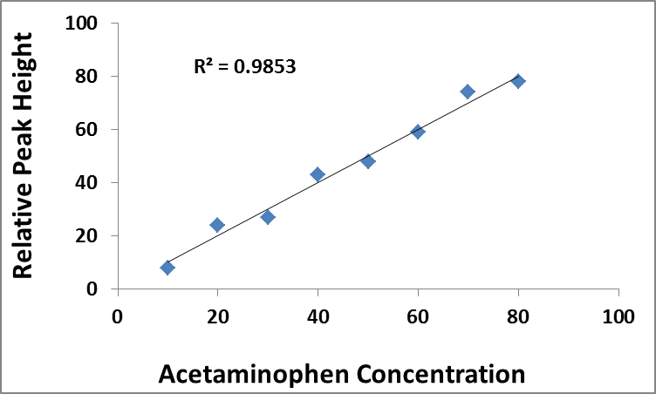
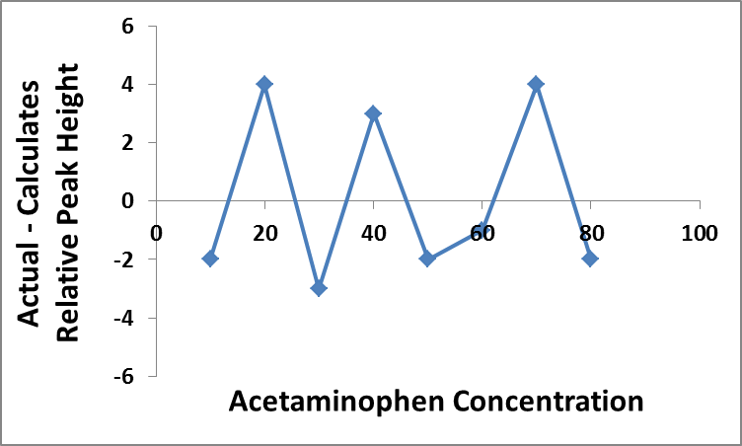
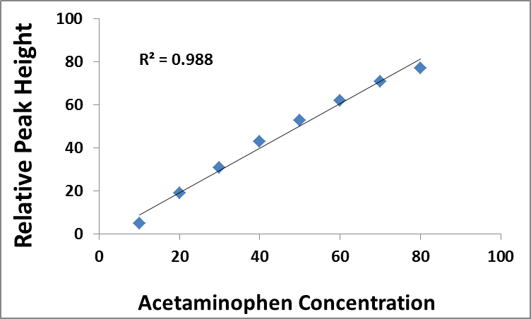
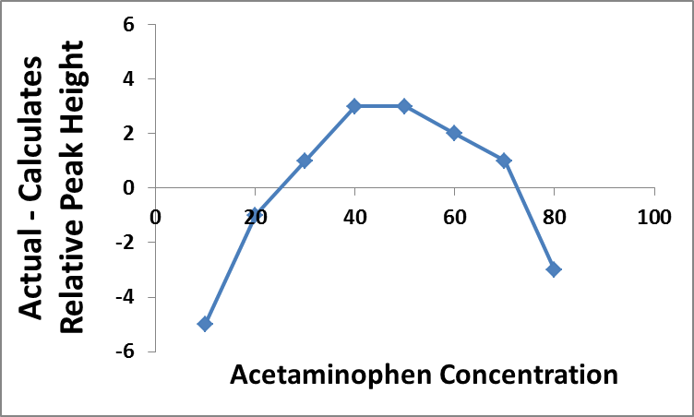
STATISTICAL TESTS FOR CHEMICAL ANALYSIS
Original Plots
Residual Plots
Good Fit
Method 1
Poor Fit
Method 2

Slide 56
STATISTICAL TESTS FOR CHEMICAL ANALYSIS
Learning Objectives
Be able to describe what is meant by a normal distribution, the general factors used to describe such a distribution, and methods for determining the probability that a given result will occur in a particular range of such a distribution.
Be able to define and calculate/use each of the following terms:
Standard deviation of the mean Confidence interval
Student’s t value Confidence level
3. Be able to describe the four items needed when using statistics to compare experimental results.
4. Be familiar with each of the following statistical tests and their use in comparing or evaluating experimental results:
Student’s t test Paired Student’s t test
F test Q test
5. Be able to discuss the process of linear regression and be able to perform the necessary calculations when using this method for a set of data.
6. Be able to use correlation coefficients and residual plots for testing the goodness of the fit of a line to data

