Slide 1
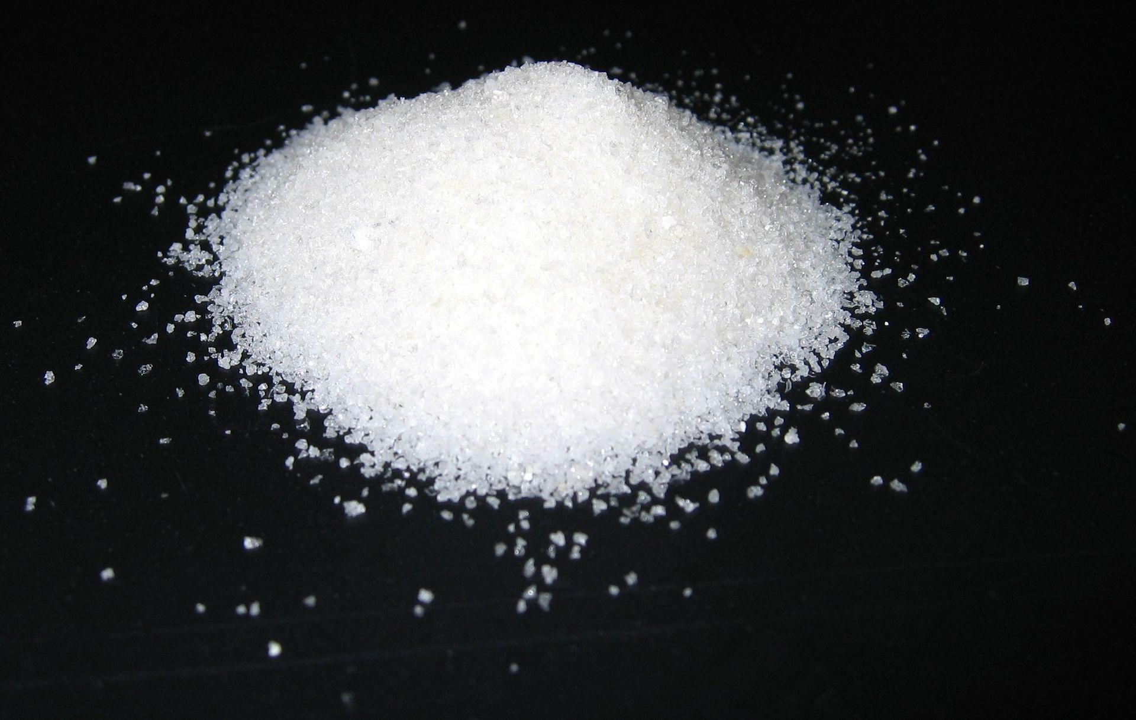
ELEMENTAL ANALYSIS
Fundamental Questions for an Analytical Chemist
What is in the sample?
How much is there?
What is the elemental composition?
[C, O, N, F, Cl, P, H, etc. ?]

Slide 2
ELEMENTAL ANALYSIS
Chemical Methods
Types of Analysis:
Qualitative Analysis:
Gives information only on whether or not a compound or element is present
Often inexpensive, manual method
Usually requires large amount of sample (μg-mg)
Quantitative Analysis:
Measures the exact amount of compound present in the sample
Performed for a known sample
Often requires high accuracy and precision
Semi-Quantitative Analysis
Identifies presence or absence of element or compound
Provides some crude measure of the amount of compound present (i.e., screening method)

Slide 3
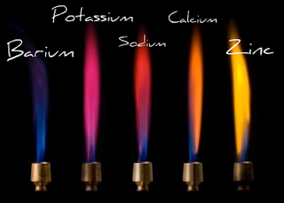
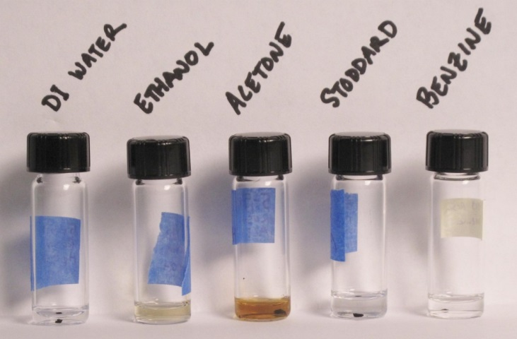
ELEMENTAL ANALYSIS
Chemical Methods
Qualitative Elemental Analysis by Chemical Methods:
Generally based on characteristic reactions and properties of elements:
Physical phase (solid/liquid/gas)
Color/spectral properties (flame test)
Solubility and volatility
Precipitation, colored products, etc.
Typically based on solution reactions:
Sample is placed in a solution before the procedure can be performed
Flame test - metal ions produce characteristic color in a flame
Solubility test - an unknown black compound is partially dissolved in ethanol and acetone

Slide 4
ELEMENTAL ANALYSIS
Chemical Methods
Methods of Sample Preparation for Elemental Analysis:
Simple sample dissolution:
Water: Good for dissolving many inorganic compounds and some organic compounds. Slight amount of acid often added to prevent hydrolysis and precipitation of metal cations
Organic solvents: Includes alcohols, chlorinated hydrocarbons, ketones, etc. Typically used to dissolve organic compounds for analysis
Mineral acids: Includes nitric acid, hydrochloric acid, aqua regia, sulfuric acid, etc. Dissolves most metals, metal alloys, metal oxides, carbonates and sulfides.
Gold dissolved in aqua regia
[1:3 mixture of nitric acid and hydrochloric acid ]

Slide 5
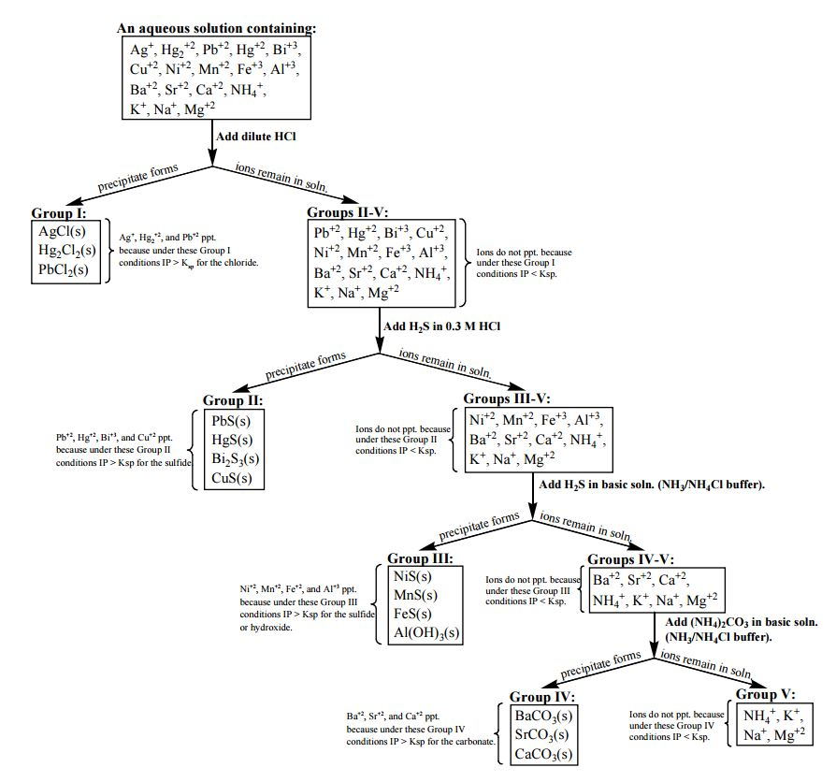
ELEMENTAL ANALYSIS
Group Separations in
Qualitative Analysis
Using Selective Precipitation

Slide 6
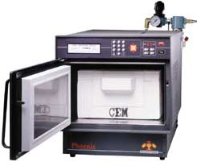
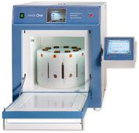
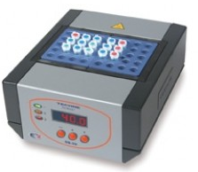
ELEMENTAL ANALYSIS
Chemical Methods
Methods of Sample Preparation for Elemental Analysis:
II. Wet Ashing
Treatment of sample with mixture of acids (i.e., perchloric and nitric acid) and heat.
Acid acts to oxidize and dissolve sample
Commonly used for elemental analysis of complex biological samples
Problem: conditions may not be harsh enough for many elements.
III. Dry Ashing:
Treatment of sample to form a metal oxide or carbonate, which is then dissolved in dilute acid
Used for elemental analysis of organic and many inorganic compounds
Problem: Low recovery for volatile elements (C, O, H)
Ashing can be done with a furnace or microwave oven

Slide 7
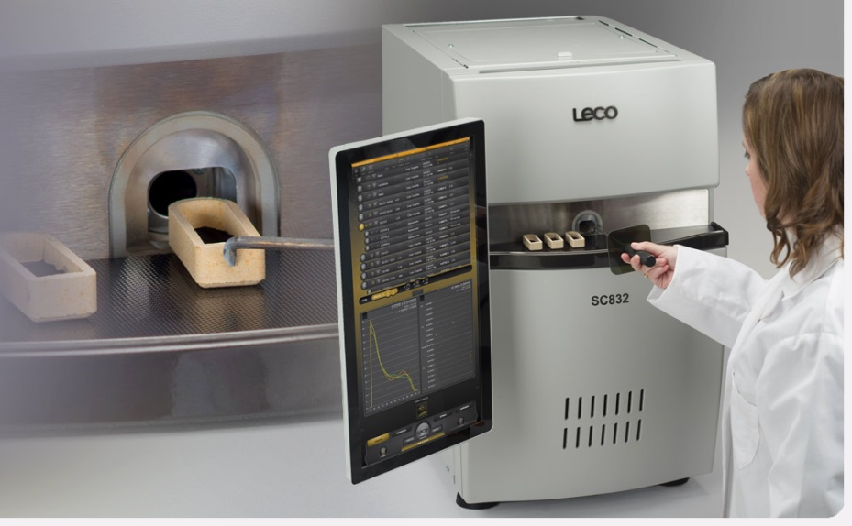
ELEMENTAL ANALYSIS
Chemical Methods
Methods of Sample Preparation for Elemental Analysis:
IV. Fusion:
Convert sample to powder and heat in the presence of a high temperature acid (potassium pyrosulfate, K₂S₂O₇), base (sodium carbonate, Na₂CO₃), or oxidizing agent (sodium peroxide, Na₂O₂) in a Pt or graphite crucible
After cooling, this converts many metallic and non-metallic elements to ionic forms soluble in dilute HCl
Commonly used in the elemental analysis of ore samples
Problem: Low recovery for volatile elements (C, O, H). Can be dangerous to perform.

Slide 8
ELEMENTAL ANALYSIS
Chemical Methods
Specific Elemental Methods: Carbon and Hydrogen Analysis
I. Combustion Analysis:
Typically used to determine C and H content of pure compounds
Based on burning the sample in the presence of excess oxygen, converting all C, H, N and S into volatile oxides:
To get at O content, method may be modified by using F₂ in place of O₂ as the oxidizing agent:
Problem: much more hazardous, difficult and expensive to do than normal combustion analysis with O₂. Best performed by robots or automated systems.

Slide 9
ELEMENTAL ANALYSIS
Chemical Methods
Specific Elemental Methods: Carbon and Hydrogen Analysis
II. Methods for Quantitation of Gases in Combustion Analysis – Gravimetric Analysis
Pass gases through series of cartridges that selectively absorb CO₂, H₂O, etc. (gas-solid extraction)
Weigh the solid cartridges before and after burning the sample.
The difference in weight is related to the amount of gas produced and the composition of the original sample.
P₄O₁₀ can be used to absorb H₂O
Ascarite (NaOH coated non-fibrous silicate) can be used to absorb CO₂
Ascarite

Slide 10
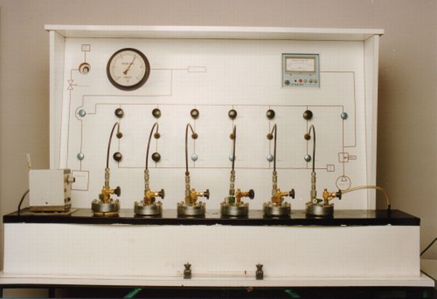
ELEMENTAL ANALYSIS
Chemical Methods
Specific Elemental Methods: Carbon and Hydrogen Analysis
II. Methods for Quantitation of Gases in Combustion Analysis – Gravimetric Analysis
Advantages of Gravimetric Analysis
Method is easy to perform and inexpensive
High accuracy and precision is possible
Sample requirement is in the μg/mg range.
Disadvantages of Gravimetric Analysis
Need complete combustion for good accuracy
Must consider selectivity of the adsorption cartridges

Slide 11
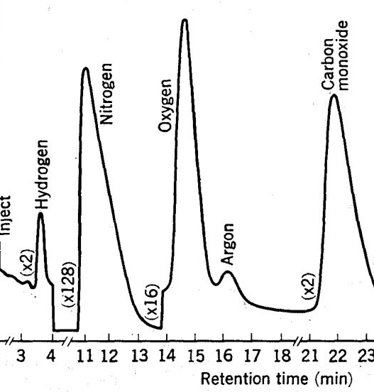
ELEMENTAL ANALYSIS
Chemical Methods
Specific Elemental Methods: Carbon and Hydrogen Analysis
III. Methods for Quantitation of Gases in Combustion Analysis – Gas Chromatography
Collect gasses produced by combustion by using a cold trap or cartridge.
Inject the mixture of gases onto a GC system to separate and quantitate individual components (e.g., CO₂, H₂O, NO₂, SO₂)
SO₂
NO₂
CO₂
Response
H₂O
inject
Illustration of cold trap
Retention time (min.)
Typical GC chromatogram

Slide 12
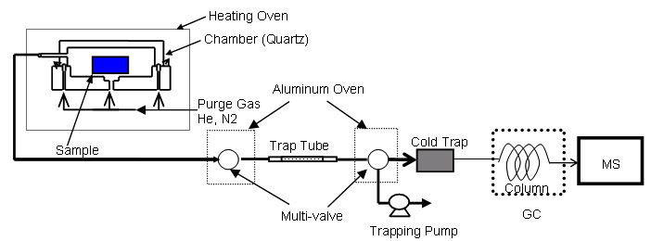
ELEMENTAL ANALYSIS
Chemical Methods
Specific Elemental Methods: Carbon and Hydrogen Analysis
III. Methods for Quantitation of Gases in Combustion Analysis – Gas Chromatography
Commonly used in professional labs for C/H analysis
Advantages of GC
Easier to perform than gravimetric analysis
Less subject to interferences from other element.
Sample requirement lower than gravimetric method (ng-μg)
Can do multiple elements in a single run
Disadvantages of GC
More expensive than gravimetric analysis

Slide 13
ELEMENTAL ANALYSIS
Chemical Methods
Specific Elemental Methods: Carbon and Hydrogen Analysis
IV. Biological Oxygen Demand (BOD)
Measure of the total organic content of a sample (simple of complex mixtures)
Used as a simple measure of organic pollutants in water samples
Measure the consumption of oxygen by microorganisms added to sample
Add microorganism
Incubate 5 days
Measure change in pressure of CO₂ released
Gives a measure of the total organics originally in the sample:

Slide 14
ELEMENTAL ANALYSIS
Chemical Methods
Specific Elemental Methods: Carbon and Hydrogen Analysis
V. Chemical Oxygen Demand (COD)
Measure of the total organic content of a sample (simple of complex mixtures)
Determined by reaction of organic compounds in sample with known amount of strong oxidizing agent (potassium dichromate, K₂Cr₂O₇)
Remaining oxidizing agent is then titrated
Measure the difference between final and initial amounts of oxidizing agent
Difference in oxidizing agent is related to the total amount of organic compounds in the original sample:

Slide 15
ELEMENTAL ANALYSIS
Chemical Methods
Specific Elemental Methods: Nitrogen Analysis
I. Kjeldahl Method:
Important in the analysis of food, fertilizers, animal feeds, etc.
A known amount of sample is first digested with boiling H₂SO₄ in the presence of a catalyst to convert all of the organic nitrogen to NH₄⁺:
Digestion:
The solution is made basic, converting all of the NH₄⁺ formed to NH₃
Distillation:
The NH₃ is distilled from the sample and collected into a solution containing a known excess of aqueous HCl
Collection:

Slide 16
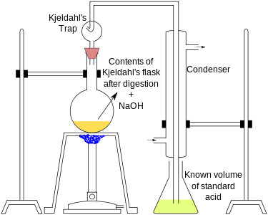
ELEMENTAL ANALYSIS
Chemical Methods
Specific Elemental Methods: Nitrogen Analysis
I. Kjeldahl Method:
Titrate unreacted HCL with NaOH
This allows the amounts of NH₃ that entered the solution to be determined
Difference between known excess of HCl and remaining HCl
Gives a measure of the organic nitrogen content of the original sample

Slide 17
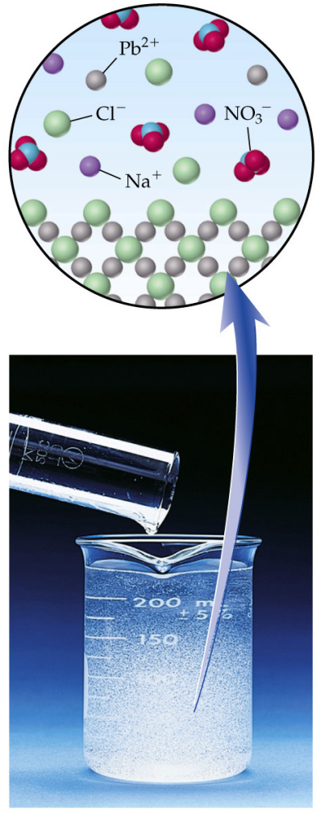
ELEMENTAL ANALYSIS
Gravimetry, Titrations & Colorimetry
Quantitative Elemental Analysis by Gravimetry
I. Gravimetry:
Use of a mass measurement to quantitate the amount of an analyte in a sample
Precipitate Pb⁺² with NaCl and measure the mass of the PbCl₂ ppt.
One of the earliest forms of analytical methods
A. L. Lavoisier, 1790-Law of conservation of mass
Can form the basis of very accurate and precise measurements
Typical accuracy ± 0.1% relative error
1 ppm precision
For example, method was used by T. W. Richards, et al. to determine the atomic weights of Ag, Cl, etc. to six significant figures in the early 1900s

Slide 18
ELEMENTAL ANALYSIS
Gravimetry, Titrations & Colorimetry
Quantitative Elemental Analysis by Gravimetry
II. General Requirements of Gravimetric Methods:
Requires known composition for the final product
Assumes no other products than the one of interest
Assumes quantitative conversion of the analyte into the final product
Need enough final product for a mass measurements
Ideal Properties of Products for Gravimetric Analysis:
Insoluble
High purity
Easy to filter (large crystals)
Known chemical composition
Few precipitates have all of these properties, but in most cases appropriate techniques can help optimize these qualities

Slide 19
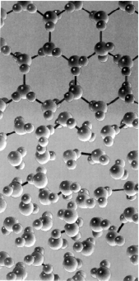
ELEMENTAL ANALYSIS
Gravimetry, Titrations & Colorimetry
Quantitative Elemental Analysis by Gravimetry
IV. Process of Crystal Growth:
Nucleation: initial stage; involves collision of molecules or ions to form small aggregates
Particle Growth: Addition of other ions or molecules to aggregate to form a crystal
Crystal Growth

Slide 20
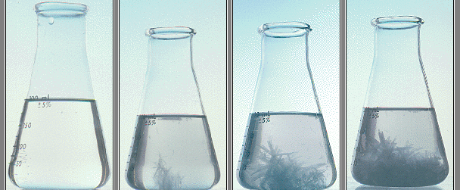
ELEMENTAL ANALYSIS
Gravimetry, Titrations & Colorimetry
Quantitative Elemental Analysis by Gravimetry
IV. Process of Crystal Growth:
Need a saturated solution to produce precipitation
Nucleation is faster than particle growth in highly concentrated solutions producing colloidal suspensions
Nucleation and Particle growth always competes for molecules/ions being precipitated
If nucleation is faster than particle growth then a large number of small aggregates occur giving a colloidal suspension
If particle growth is faster than nucleation then only a few, large particles form giving pure crystals
Want to
Convert to
Colloidal suspension
Crystal formation

Slide 21
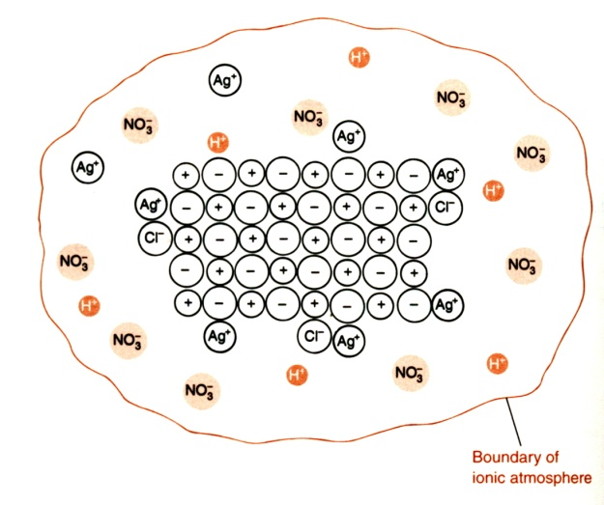
ELEMENTAL ANALYSIS
Gravimetry, Titrations & Colorimetry
Quantitative Elemental Analysis by Gravimetry
IV. Process of Crystal Growth:
Rates of nucleation vs. particle growth depends on:
Amount of precipitation solute present
Described by a quantity known as the Relative Supersaturation (R)
If R is large,
Large relative amount of solute in solution
Favors nucleation and colloid formation
A small value of R (~ 1.0) is desired in order to favor crystal growth
S = Molecule or ion concentration ate equilibrium
(i.e., the solubility limit when the solution is in contact with precipitate
Q = Actual molecule or ion concentration under the given
precipitation conditions (not at equilibrium)
Colloidal Particle

Slide 22
ELEMENTAL ANALYSIS
Gravimetry, Titrations & Colorimetry
Quantitative Elemental Analysis by Gravimetry
V. Methods for Minimizing R:
Increase temperature of solution
Increases S
Increase amount of solute that can be in solution at equilibrium
Add precipitating reagent slowly while vigorously mixing solution
Avoids local high concentrations of solution
Avoids nucleation and colloid formation
Keep volume of solution large
Keep concentration of analyte and precipitating reagent low
Control S by chemical means
By adjusting pH
By adding complexing agent, example: precipitation of Ca²⁺ with C₂O₄²⁻
Note: As pH ([H⁺]) changes, the solubility of CaC₂O₄ changes
C₂O₄²⁻ + H⁺ HC₂O₄⁻
Ca²⁺ + C₂O₄²⁻ CaC₂O₄(s)
K_{sp}

Slide 23
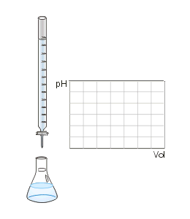
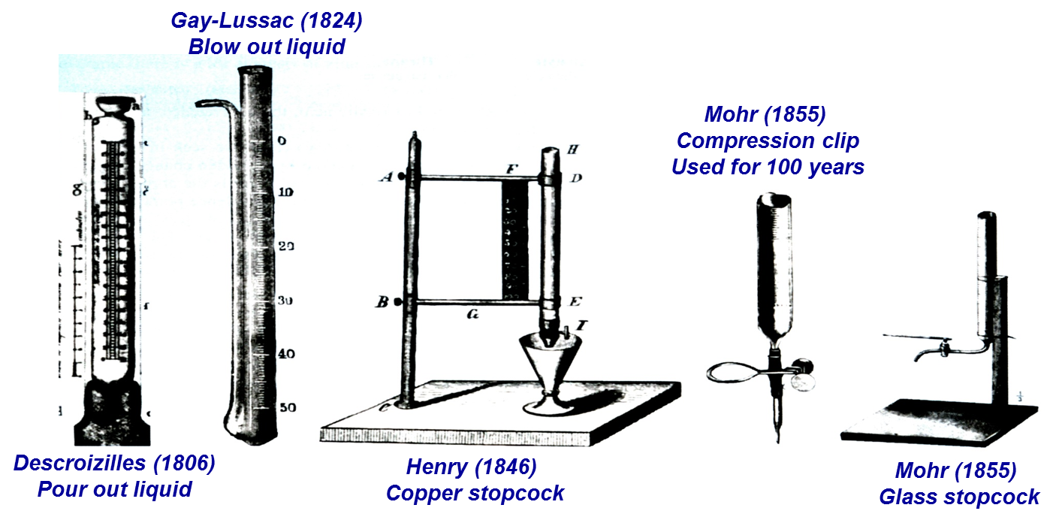
ELEMENTAL ANALYSIS
Gravimetry, Titrations & Colorimetry
Quantitative Elemental Analysis by Titrations
I. Titration (Volumetric Analysis):
Method for quantitating analyte based on measuring the volume of a reagent that is required to react with the analyte
Also an early analytical method
France, 1830-silver titration
Capable of high precision,
Accuracy can be in the range of ± 1 ppt relative error
Favors nucleation and colloid formation

Slide 24
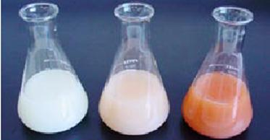
ELEMENTAL ANALYSIS
Gravimetry, Titrations & Colorimetry
Quantitative Elemental Analysis by Titrations
I. Precipitation-Based Titrations:
Example: Titration of Ag⁺ with Cl⁻
Monitor a change in color
Solution changes from white to brick-red as Ag⁺ is depleted

Slide 25
ELEMENTAL ANALYSIS
Gravimetry, Titrations & Colorimetry
Quantitative Elemental Analysis by Titrations
I. Redox Titrations:
Example: Titration of Fe²⁺ with Ce⁴⁺
Monitor a change in potential

Slide 26
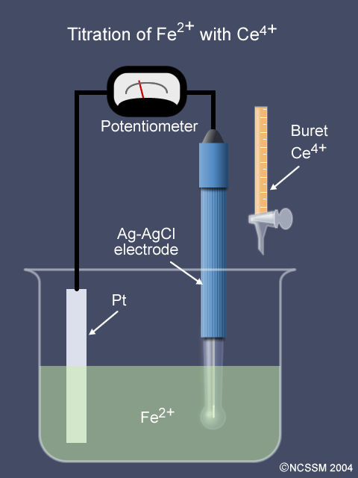
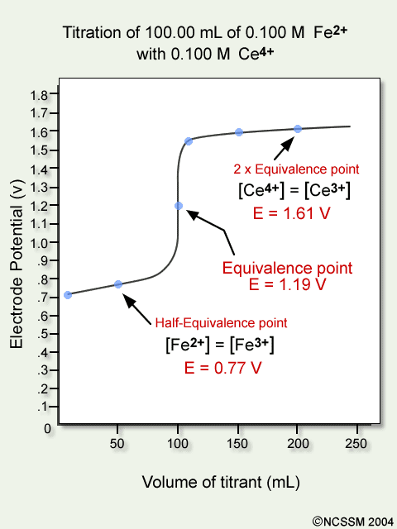
ELEMENTAL ANALYSIS
Gravimetry, Titrations & Colorimetry
Quantitative Elemental Analysis by Titrations
I. Redox Titrations:
Example: Titration of Fe²⁺ with Ce⁴⁺

Slide 27
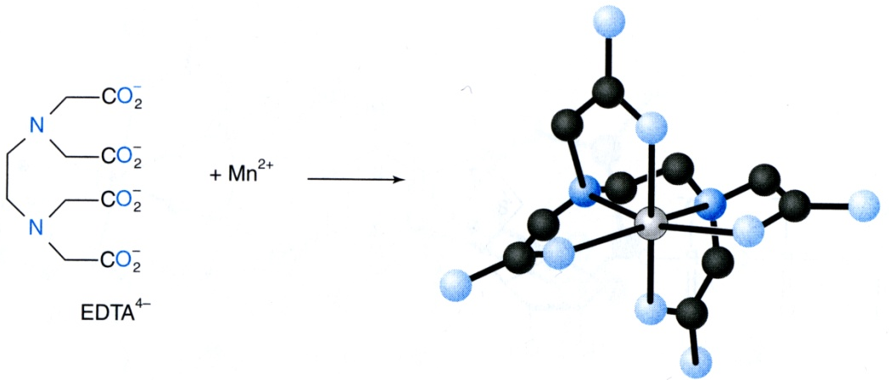
ELEMENTAL ANALYSIS
Gravimetry, Titrations & Colorimetry
Quantitative Elemental Analysis by Titrations
I. Complexometric Titrations:
General reaction when using EDTA as a complexing agent:
Note: multiple atoms from EDTA are binding Mn²⁺
Metal – Lewis Acid or Electron-pair acceptor
Ligand – Lewis Base or Electron-pair donor

Slide 28
ELEMENTAL ANALYSIS
Gravimetry, Titrations & Colorimetry
Quantitative Elemental Analysis by Titrations
I. Complexometric Titrations:
EDTA (Ethylenediaminetetraacetic acid) has 6 nitrogens & oxygens in its structure giving it 6 free electron pairs that it can donate to metal ions.
High K_{f} values
6 acid-base sites in its structure

Slide 29
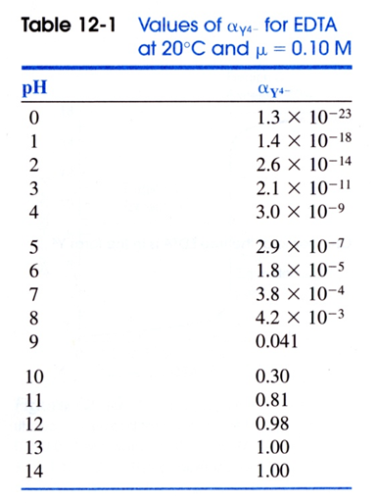
ELEMENTAL ANALYSIS
Gravimetry, Titrations & Colorimetry
Quantitative Elemental Analysis by Titrations
I. Complexometric Titrations:
General reaction when using EDTA as a complexing agent:

Slide 30
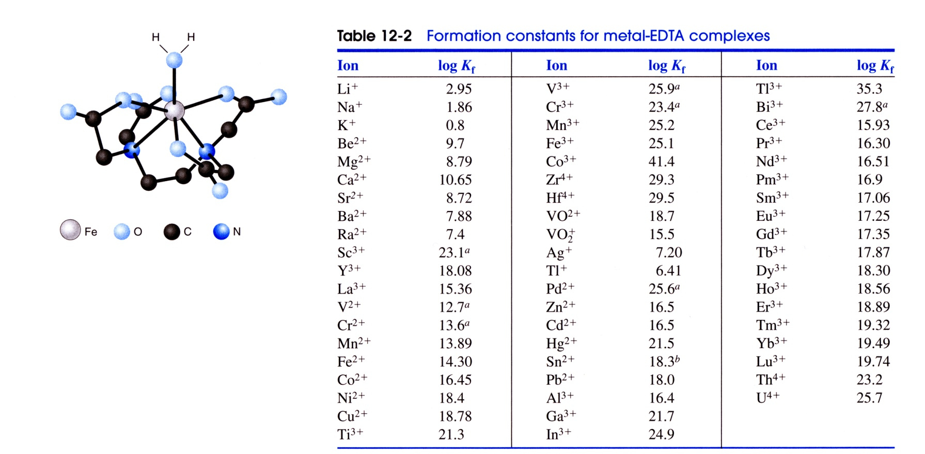
ELEMENTAL ANALYSIS
Gravimetry, Titrations & Colorimetry
Quantitative Elemental Analysis by Titrations
I. Complexometric Titrations:
EDTA reacts with most ions to form a tight, essentially irreversible 1:1 complex:

Slide 31
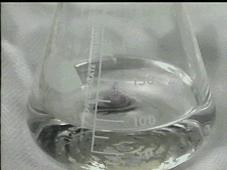
ELEMENTAL ANALYSIS
General requirements of titrations:
1. Based on solution-phase reactions (i.e., the sample must first be placed in solution before the procedure can be performed)
2. Requires known reaction and stoichiometry between the analyte and titrant
3. Assumes no reaction other than the one of interest occurs
4. Reagent used as the titrant should have a large equilibrium constant and fast rate of reaction with the analyte
5. Must be possible to make up the titrant with a known composition and purity
6. Needs means of detecting the end of the titration

Slide 32
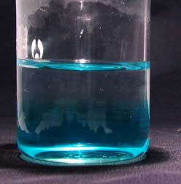
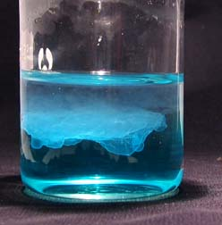
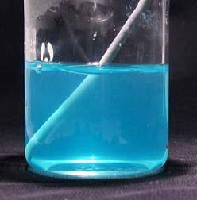
ELEMENTAL ANALYSIS
Gravimetry, Titrations & Colorimetry
Quantitative Elemental Analysis by Titrations
Equivalence Point: the point at which the amount of titrant add is exactly equal to the amount needed to give stoichiometric consumption of the analyte
End Point: the point at which the amount of titrant produces an observable change during the titration, signaling the complete or near complete consumption of analyte (the actual case)
CuCl Titration with NaOH
Before any addition of NaOH
After the addition of 8 drops of NaOH
End Point

Slide 33
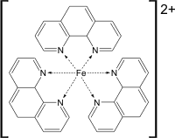
ELEMENTAL ANALYSIS
Gravimetry, Titrations & Colorimetry
Common Methods for End Point Detection
I. Precipitation-Based Titrations:
Ion Selective Electrode (e.g., pH meter) for analyte, titrant or product
Mercury Electrode set at a potential to detect analyte, titrant or product
Visual observations or light scattering measurements
II. Redox Titrations:
Ion Selective Electrode (e.g., pH meter) for analyte, titrant or product
Mercury Electrode set at a potential to detect analyte, titrant or product
Redox Indicator:
Complexing Agents:
starch + I₃⁻ → starch-I₃⁻ complex
(clear) (deep blue)

Slide 34
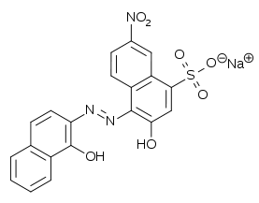
ELEMENTAL ANALYSIS
Gravimetry, Titrations & Colorimetry
Common Methods for End Point Detection
III. Complexometric Titrations:
Ion Selective Electrode (e.g., pH meter) for analyte, titrant or product
Mercury Electrode set at a potential to detect analyte, titrant or product
Metal Ion Indicator:
Use of Eriochrome black T (In) as indicator for titration of Mg⁺² with EDTA

Slide 35
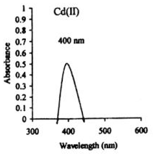
ELEMENTAL ANALYSIS
Gravimetry, Titrations & Colorimetry
Quantitative Elemental Analysis by Colorimetry
I. Colorimetry (Visible Spectrometric Analysis):
Method for quantitating analyte based on measuring the absorbance of light by the analyte, or a species that is formed by or reacts with the analyte
Example: Determination of Cd²⁺ with Hydroxyquinoline
One of the first instrumental analytical methods
Beckman, 1930’s
Capable of moderate accuracy and precision,
Limits of detection lower than titrations or gravimetry
Jour. Chem. Soc. Pak, 2001 27(5) 471

Slide 36
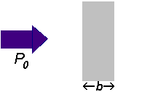
ELEMENTAL ANALYSIS
Gravimetry, Titrations & Colorimetry
Quantitative Elemental Analysis by Colorimetry
II. Process of Absorption
Light Source Sample Detector
I_{o}
I
where: I_{o} = Initial intensity of light
I = Final intensity of light
%T = percent transmittance of light

Slide 37
ELEMENTAL ANALYSIS
Gravimetry, Titrations & Colorimetry
Quantitative Elemental Analysis by Colorimetry
III. Beer-Lambert Law (Beer’s Law):
where: ε = Molar absorptivity (units, L/mol-cm)
b = Path length of light through sample (cm)
c = Concentration of absorbing species (mol/L)
A = Absorbance
= -log(I/I_{o})
= -log(%T/100)

Slide 38
ELEMENTAL ANALYSIS
Gravimetry, Titrations & Colorimetry
Quantitative Elemental Analysis by Colorimetry
IV. Assumptions behind Beer’s Law:
All absorbing species act independently of each other
The light being used for the absorbance measurement is “monochromatic”
All detected rays of light that pass through the sample have the same distance of travel
The concentration of absorbing species is constant throughout the path of light in the sample
The light that is being used to measure the absorbance is not scattered by the sample
The amount of light entering the sample is not large enough to cause saturation of the absorbing species in the sample

Slide 39
ELEMENTAL ANALYSIS
Gravimetry, Titrations & Colorimetry
Quantitative Elemental Analysis by Colorimetry
IV. Limitations of Beer’s Law – a consequence of the assumptions in Beer’s law
Non-linearities due to intermolecular interactions
Self-aggregation effects and electrolyte effects
Dynamic dissociation or association of analyte
Instrumental –Polychromatic radiation
Different molar adsorptivities at different wavelengths leads to non-linearities in Beer’s Law
Stray Radiation
Mis-matched cells
Non-zero intercept in calibration curve
In Reality:

Slide 40
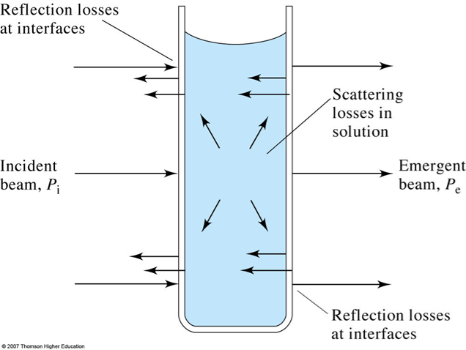
ELEMENTAL ANALYSIS
Gravimetry, Titrations & Colorimetry
Quantitative Elemental Analysis by Colorimetry
Errors in Applying Beer’s Law to measure a concentration
Need to keep A in range of 0.1 – 1.5 absorbance units (80 -3%T)

Slide 41
ELEMENTAL ANALYSIS
Gravimetry, Titrations & Colorimetry
Quantitative Elemental Analysis by Colorimetry
VI. Manual Colorimetric Measurements
Equilibrium-Based Measurements:
Allow reaction of analyte and reagent to reach completion
Absorbance measurement of the final solution – endpoint measurement
Kinetic-Based Measurements:
Follows the consumption of analyte or reagent; or the production of the product
Absorbance measurement as a function of time
2 minutes
5 minutes
30 minutes
Negative controls:
Hydrogen peroxide produced
in the glucose oxidase reaction:
Analytical methods 2014 6(14):10.1039/c4ay00260a

Slide 42
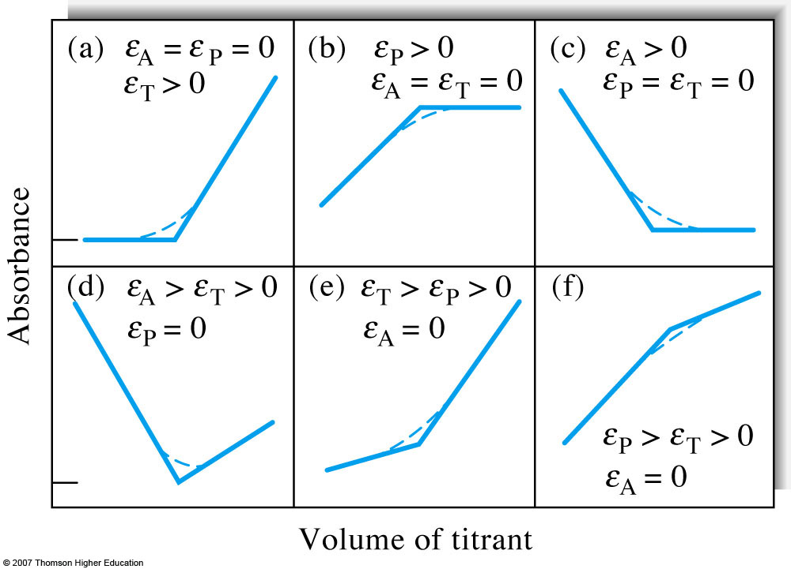
ELEMENTAL ANALYSIS
Gravimetry, Titrations & Colorimetry
Quantitative Elemental Analysis by Colorimetry
VI. Manual Colorimetric Measurements
Photometric Titrations:
Use of absorbance measurements to follow the progress of a titration

Slide 43
ELEMENTAL ANALYSIS
Gravimetry, Titrations & Colorimetry
Quantitative Elemental Analysis by Colorimetry
VI. Automated Colorimetric Measurements
Flow-Injection Analysis (FIA):
Injection of a sample into a system that combines the sample with one or more reagents that results in the formation of a measurable product
Flow-injection determination of chloride (a) flow diagram and (b) recorder readout for quadrupole runs on standard containing 5 to 75 ppm of chloride ion
(Ruzicka & Hansen Flow Injection Methods 2nd ed. p. 16, New York: Wiley 1988)

Slide 44
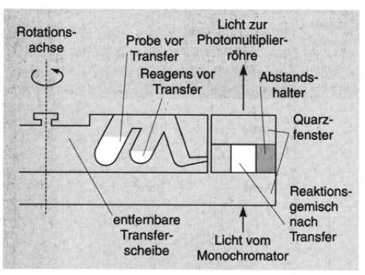
ELEMENTAL ANALYSIS
Gravimetry, Titrations & Colorimetry
Quantitative Elemental Analysis by Colorimetry
VI. Automated Colorimetric Measurements
Centrifugal Analysis:
Use a centrifuge-type system to add, mix, and incubate sample and reagents for absorbance measurements
Axis of
rotation
Light to
Photomultiplier
tube
Sample before transfer
Reagent before transfer
Spacer
Quartz
windows
Reaction mixture
after transfer
Removable
transfer disk
Light from
monochromator
Coleman et al .Amer. Lab., 1971 3(7):26

Slide 45
ELEMENTAL ANALYSIS, GRAVIMETRY, TITRATIONS & COLORIMETRY
Learning Objectives
1. Be able to define or describe each of the following methods and describe how they can be used for quantitative analysis:
Gravimetry Colorimetry Centrifugal Analysis
Titrations: Flow-Injection Analysis
Precipitation-Based
Redox
Photometric Titration
Complexometric (EDTA)
2. Be able to compare and contrast the advantages and disadvantages of gravimetry, titrations and colorimetric methods. Know the general requirements of each of these methods.
3. Be able to perform typical calculations that are involved in the use of each of the above techniques during the quantitative analysis of samples
4. Be able to describe the ideal properties of a product in gravimetric analysis and be able to relate this to the processes involved in crystal growth
5. Be familiar with common methods used for end point detection in precipitation-based, redox and complexometric titrations
6. Know Beer’s Law, how it is related to the process of light absorption, and the assumptions behind this law.

